Slide 1
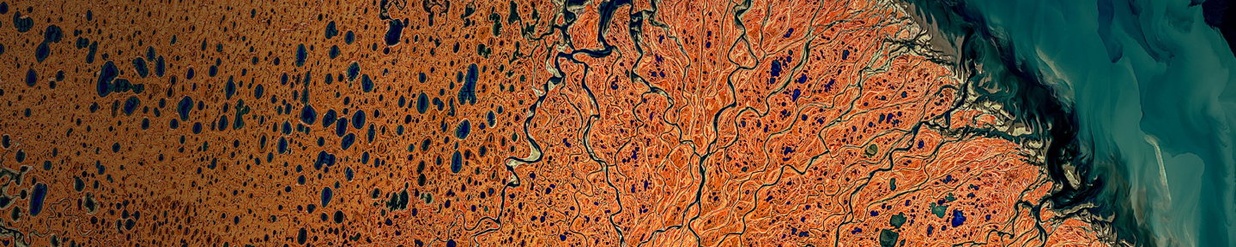
Lonboard: Fast, interactive geospatial data visualization
With a heavy dose of Apache Arrow
Kyle Barron, Development Seed

Slide 2
My background
How is Lonboard so fast?
What is Lonboard? & Demos
Data protocols for geospatial data

Slide 3
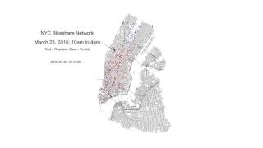
My background
Economics & math at UCLA
Interested in data science via economic research
Learned Stata first, then R
Hacking in R was fun!
(It’s an R meetup, have to burnish my R credentials…)

Slide 4
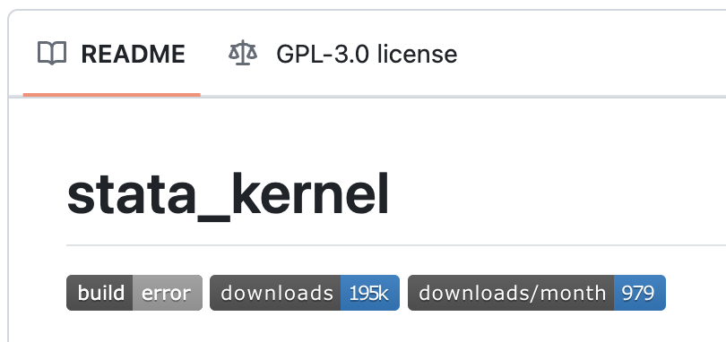


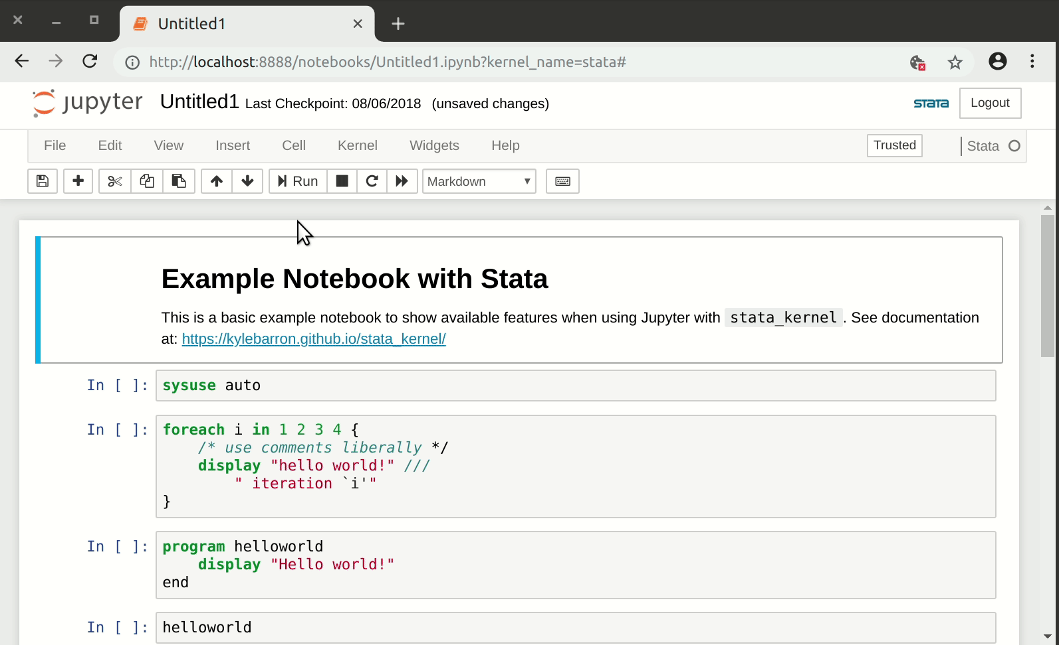
Economic Research
Economics research assistant at NBER/MIT (2017-2019)
Spent my time building tooling (in Python), slacked on the research side
Excited about interactive programming in Jupyter & multi-language data interoperability (Stata + R + Python)
PhD wasn’t for me

Slide 5
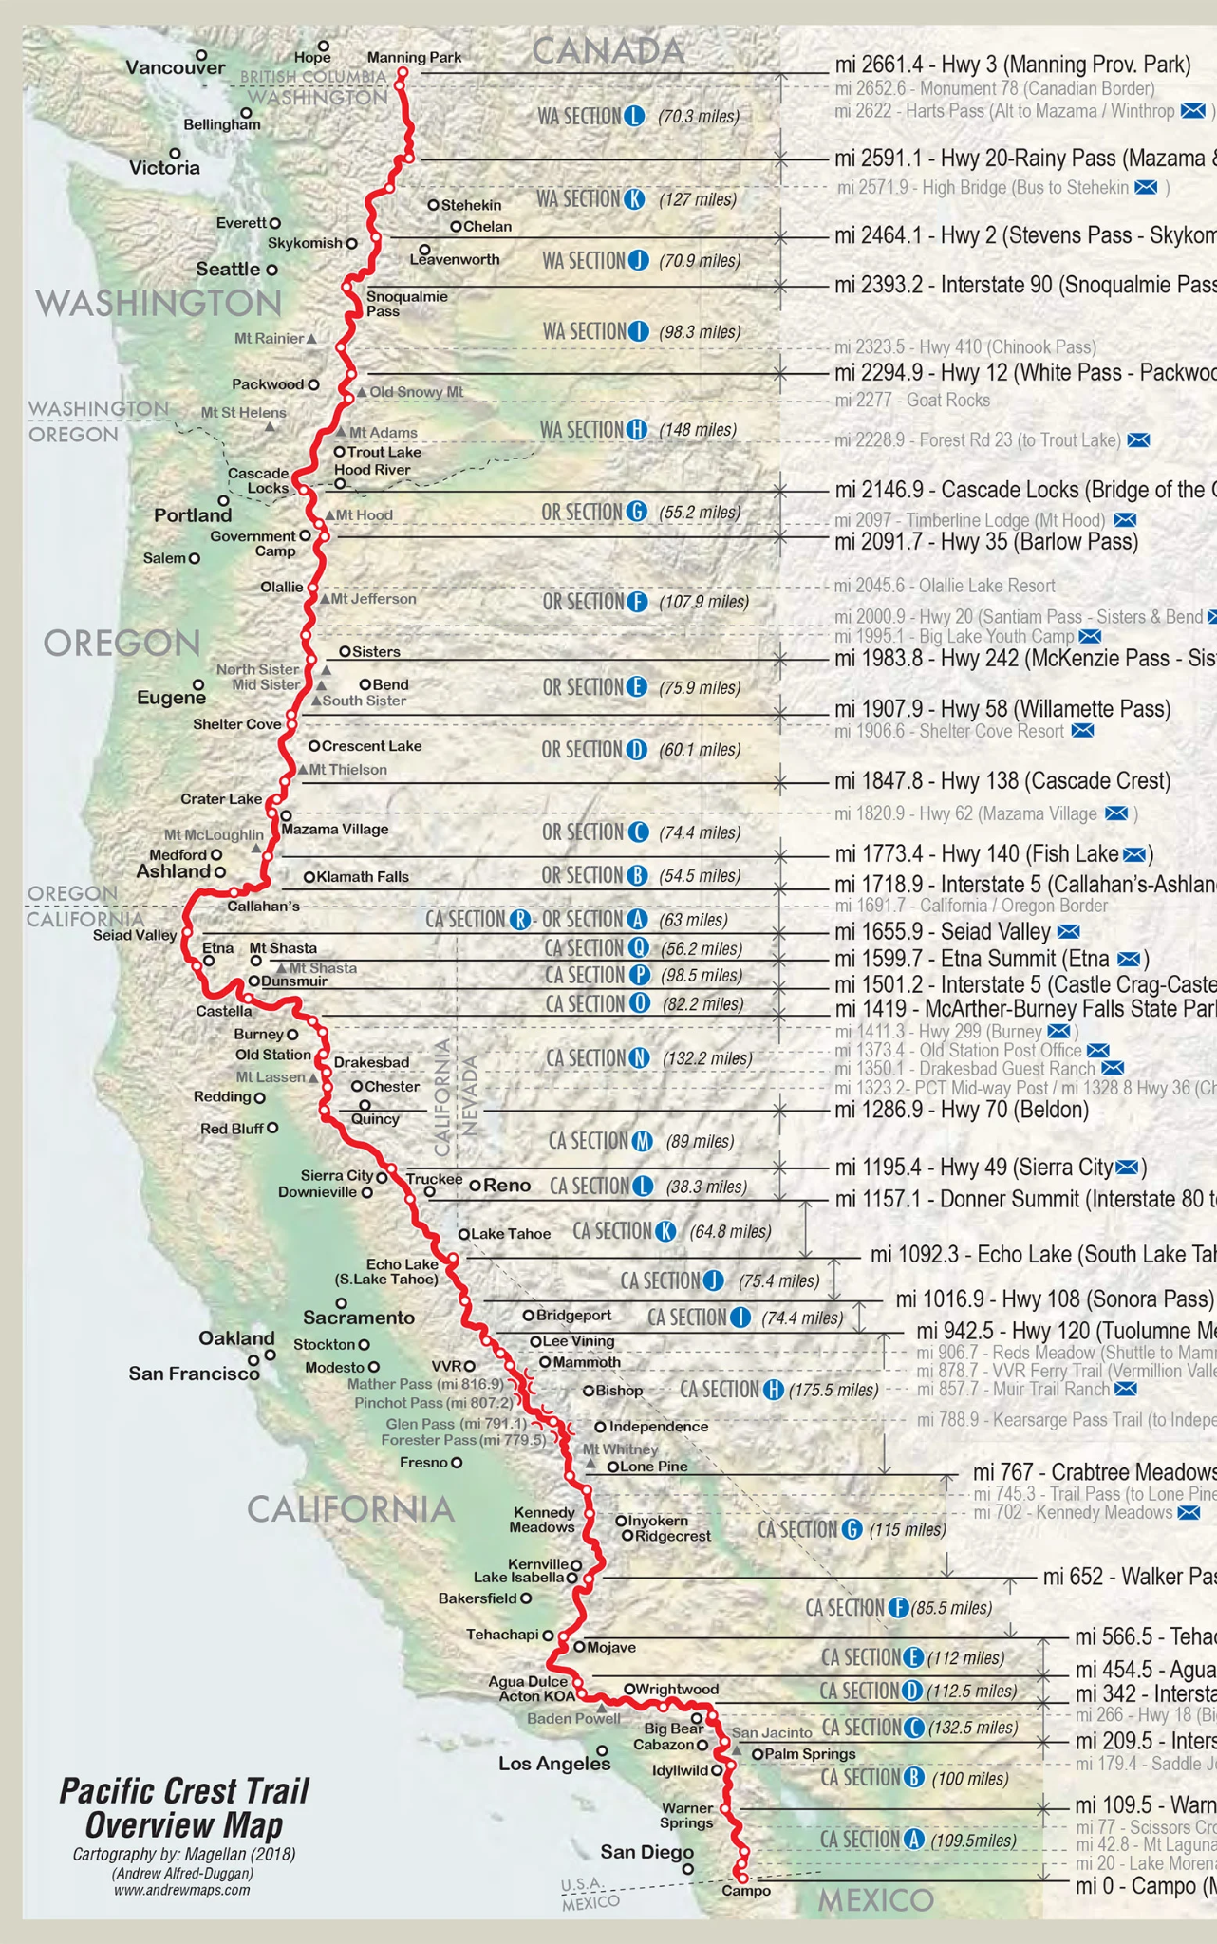
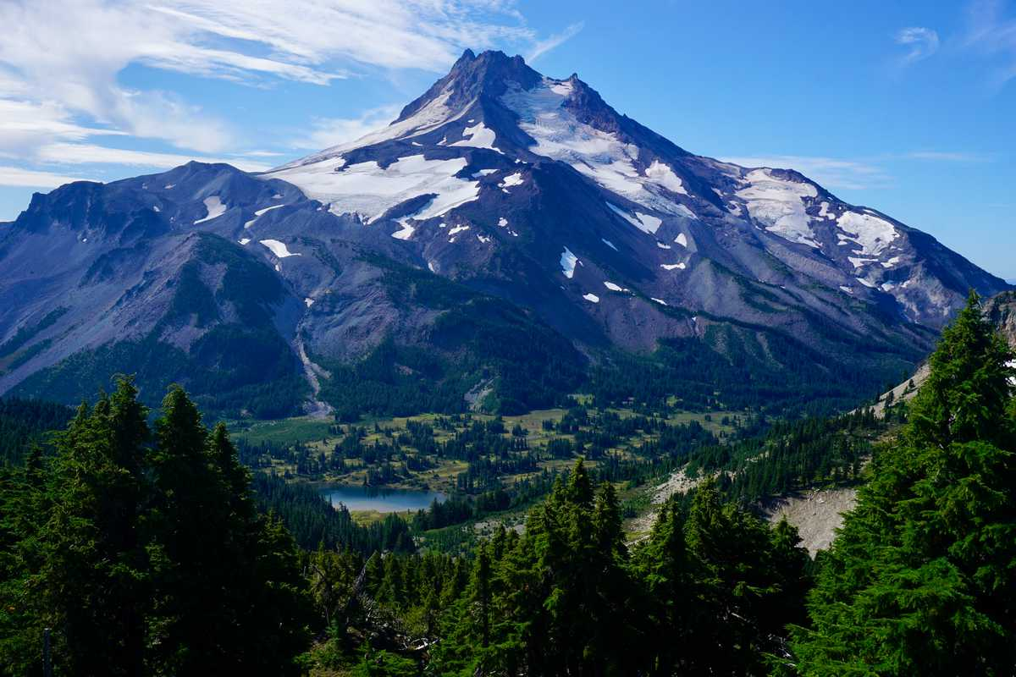
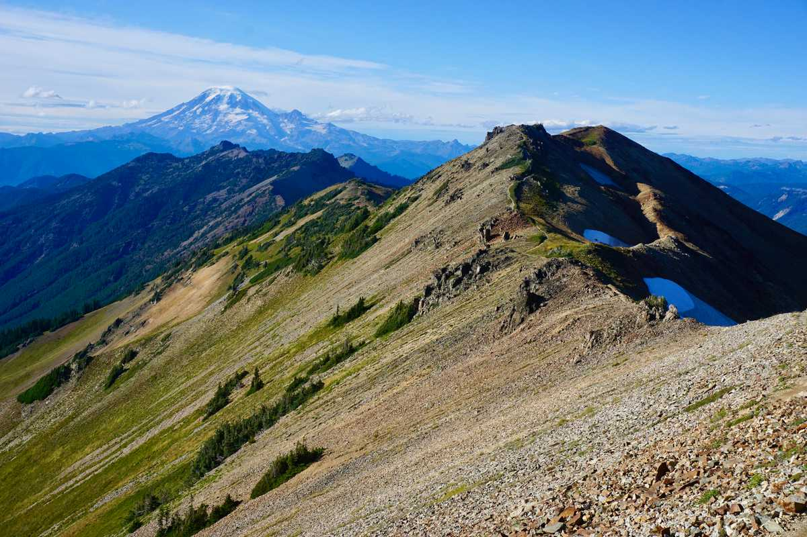
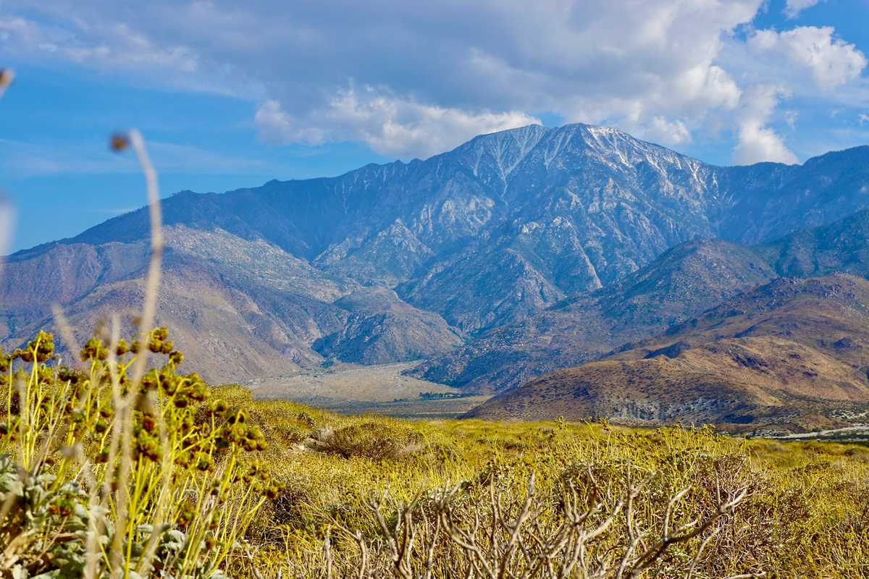
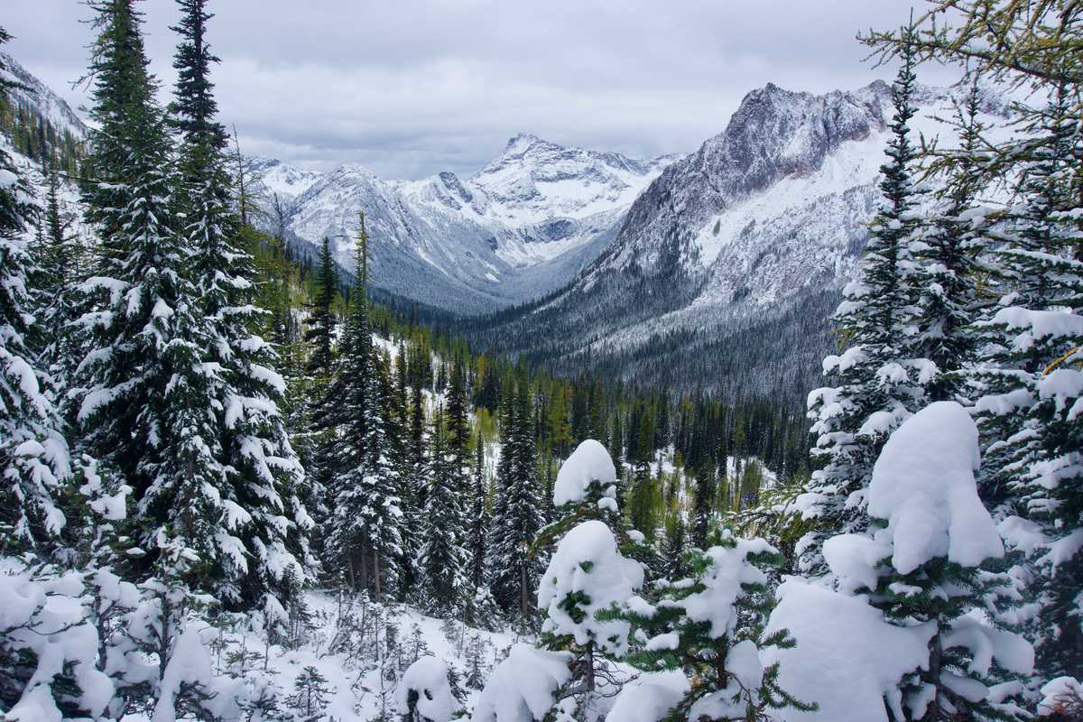
Went for a hike!
Hiked 2650-mile Pacific Crest Trail over 5 months
Halfway through decided that I could build a better hiking app for the PCT

Slide 6
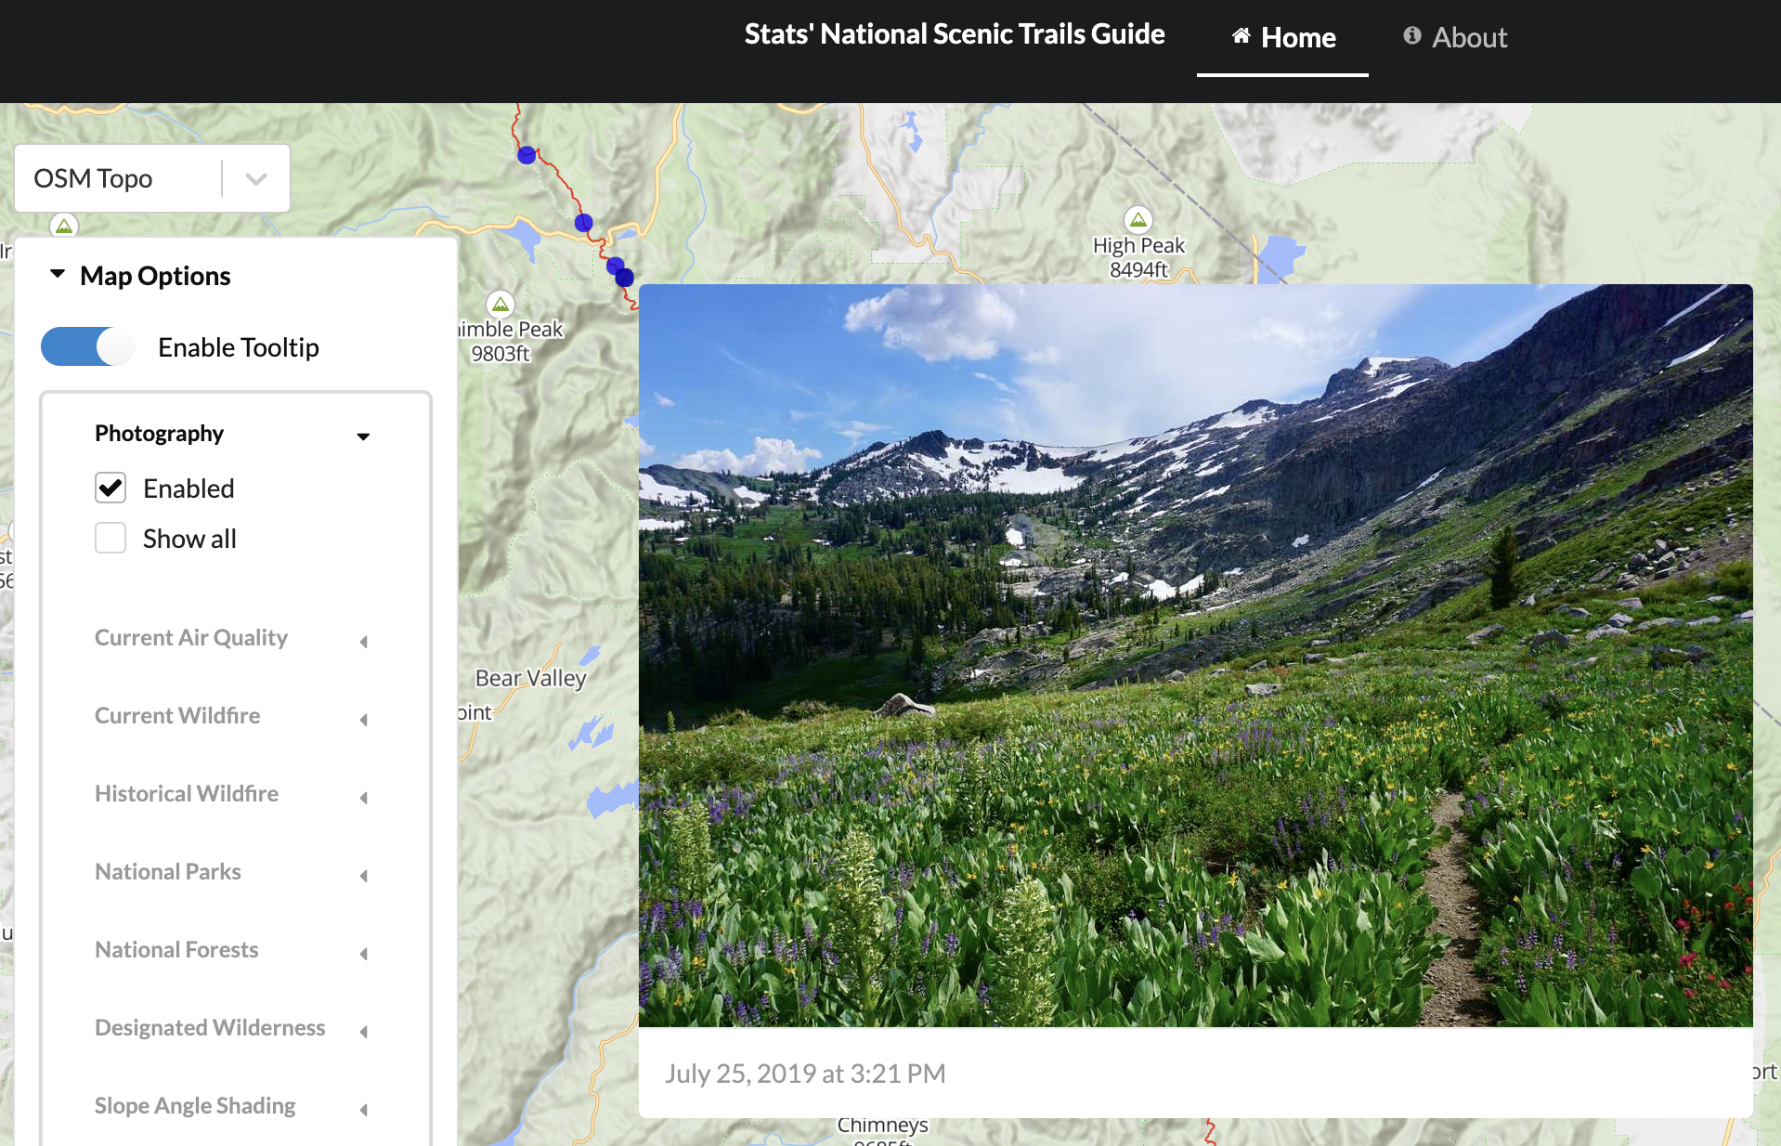
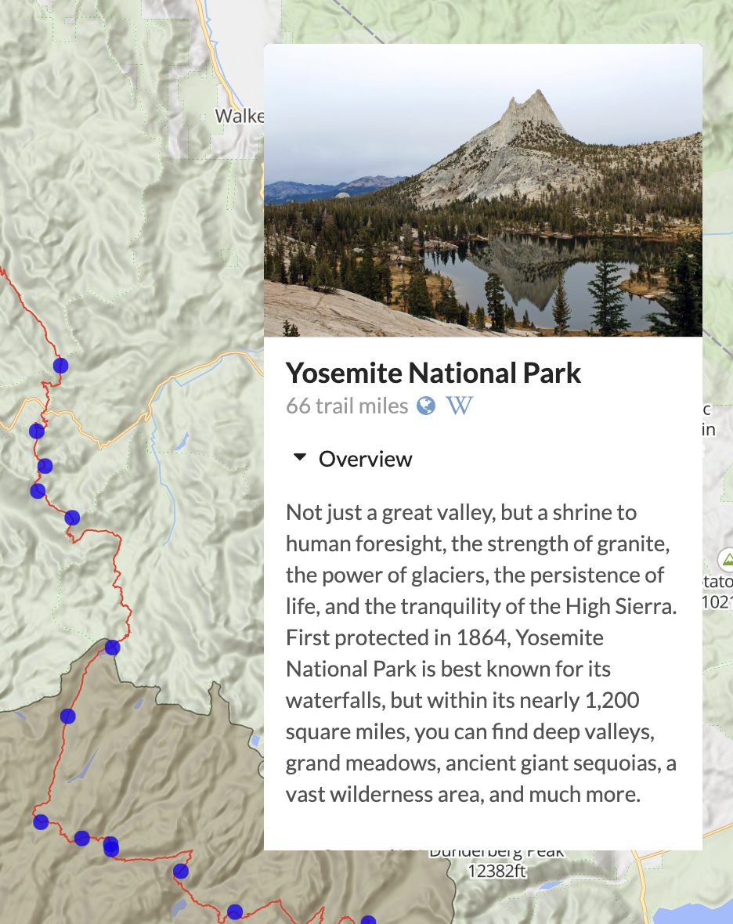
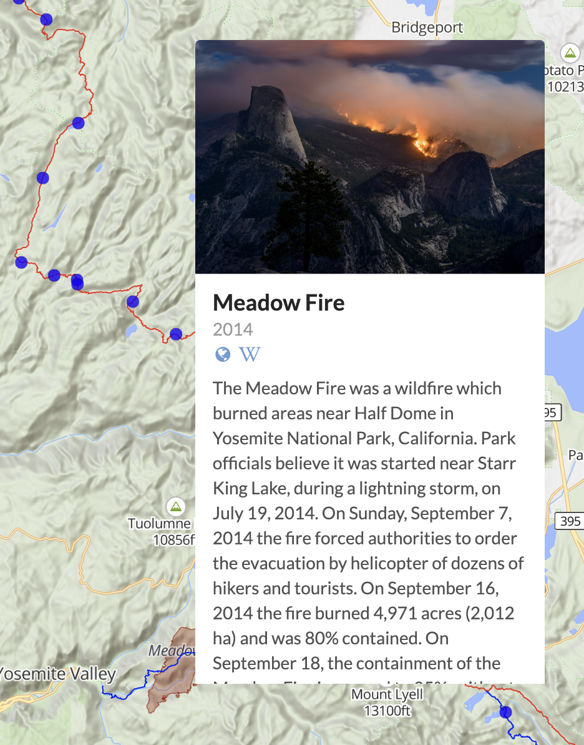
Back in the parents’ nest
Built a map!
Joined geospatial data sources with geopandas
Learned about coordinate reference systems
Created my own OSM vector tiles, hillshading, contour lines, raster tiles
Learned JavaScript, React
Used Mapbox GL, deck.gl
Still online nst.guide and on github github.com/nst-guide

Slide 7

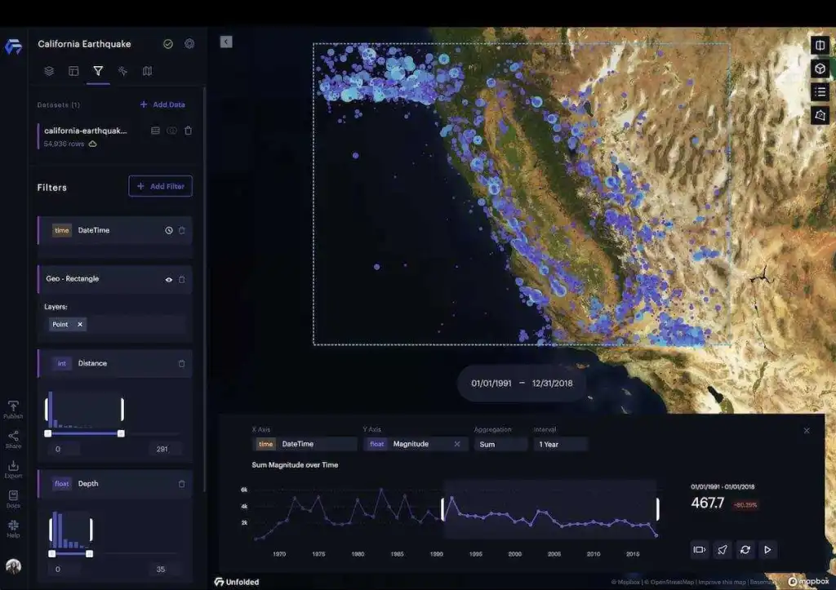
Landed a job!
Github networking worked!
deck.gl maintainers had just left Uber to found a company
Wrote low-level TypeScript parsers for various file formats (Shapefile, WKB)
Wrote Python library to use Unfolded in Jupyter
WebGL raster data visualization

Slide 8
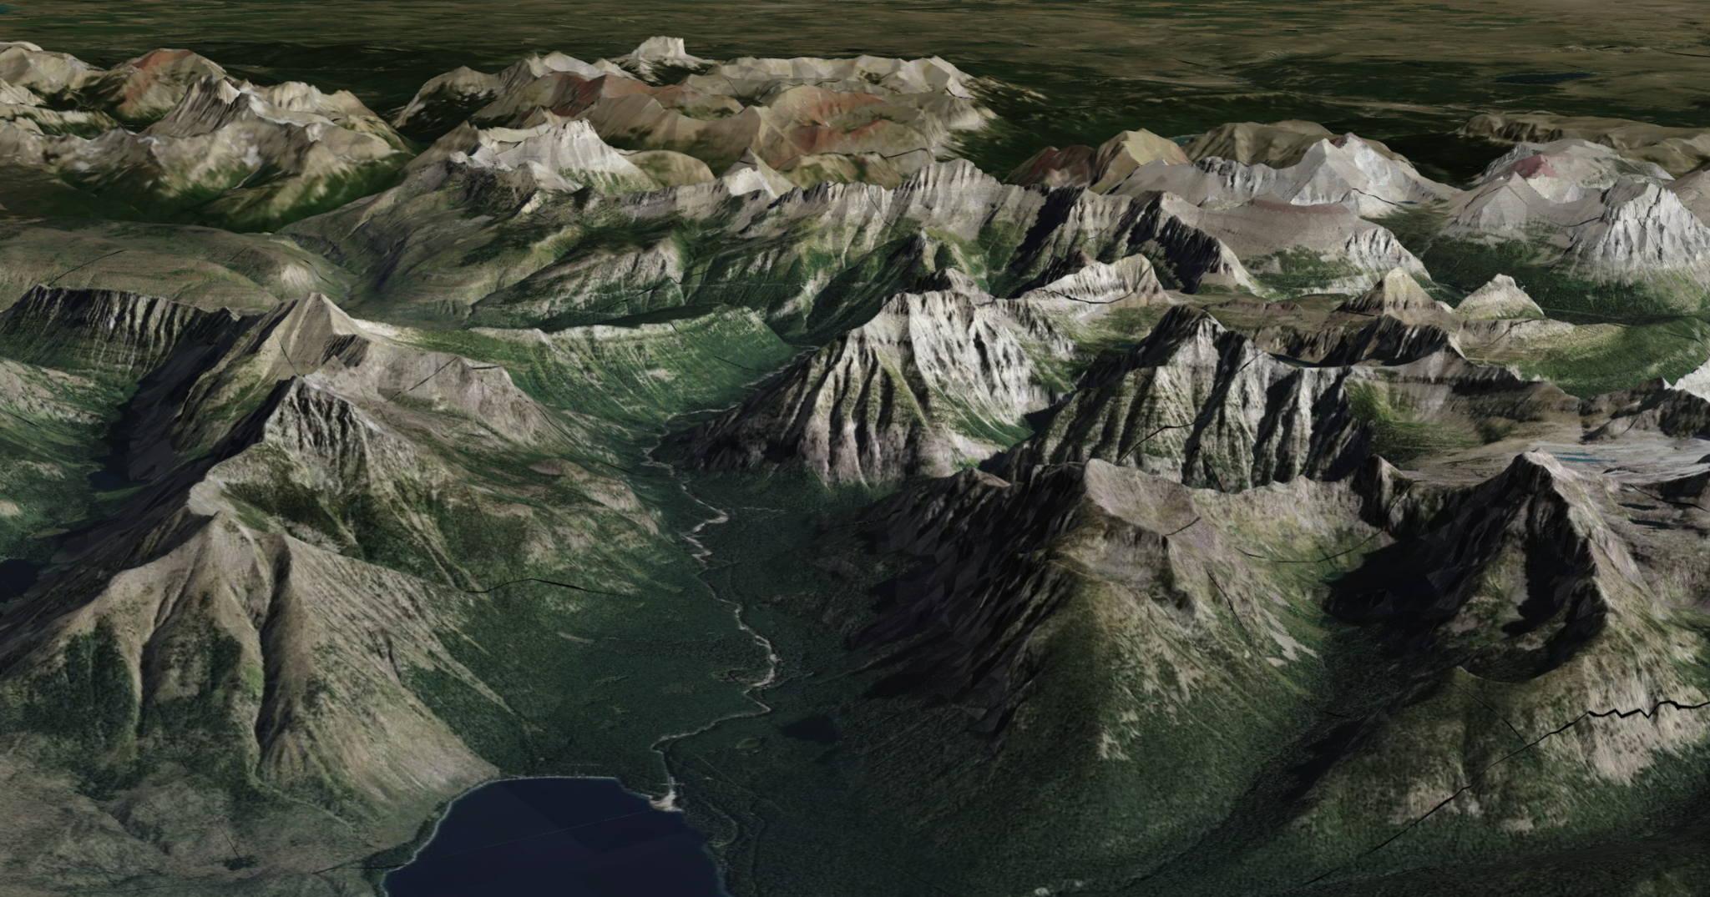
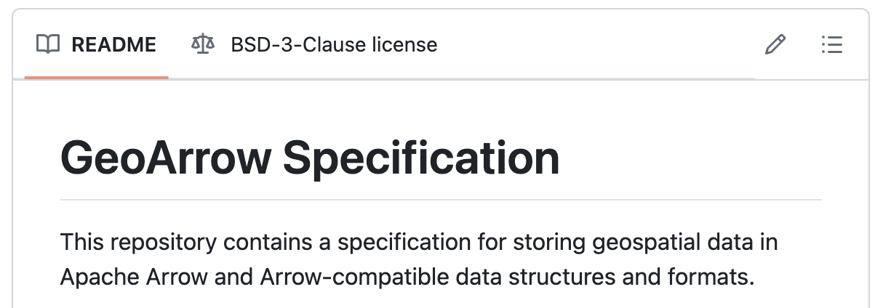
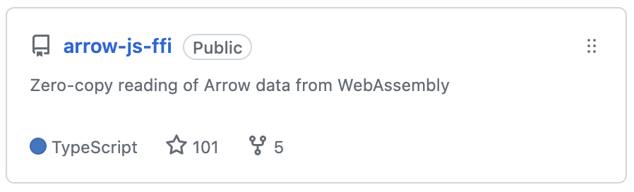
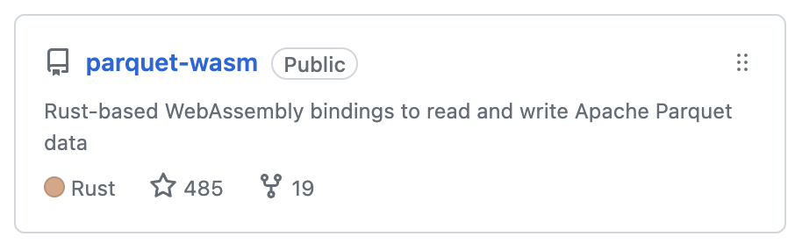
Open-source side projects
Terrain mesh generation and visualization
Modern data formats for geospatial data
Rust for WebAssembly and Python
Zero-copy data exchange with Arrow

Slide 9




Developed my technical interests
Geospatial data visualization (e.g. deck.gl)
Interactive computing (e.g. Jupyter)
Broad accessibility (e.g. browser)
Data interoperability & multi-language workflows for data science (e.g. Parquet + Arrow)
Low level binary data representation (Arrow)
Fast, compiled code (Rust, Cython)
Notes:
I think it’s useful to go through my background because it’s where I developed a lot of my interests:

Slide 10
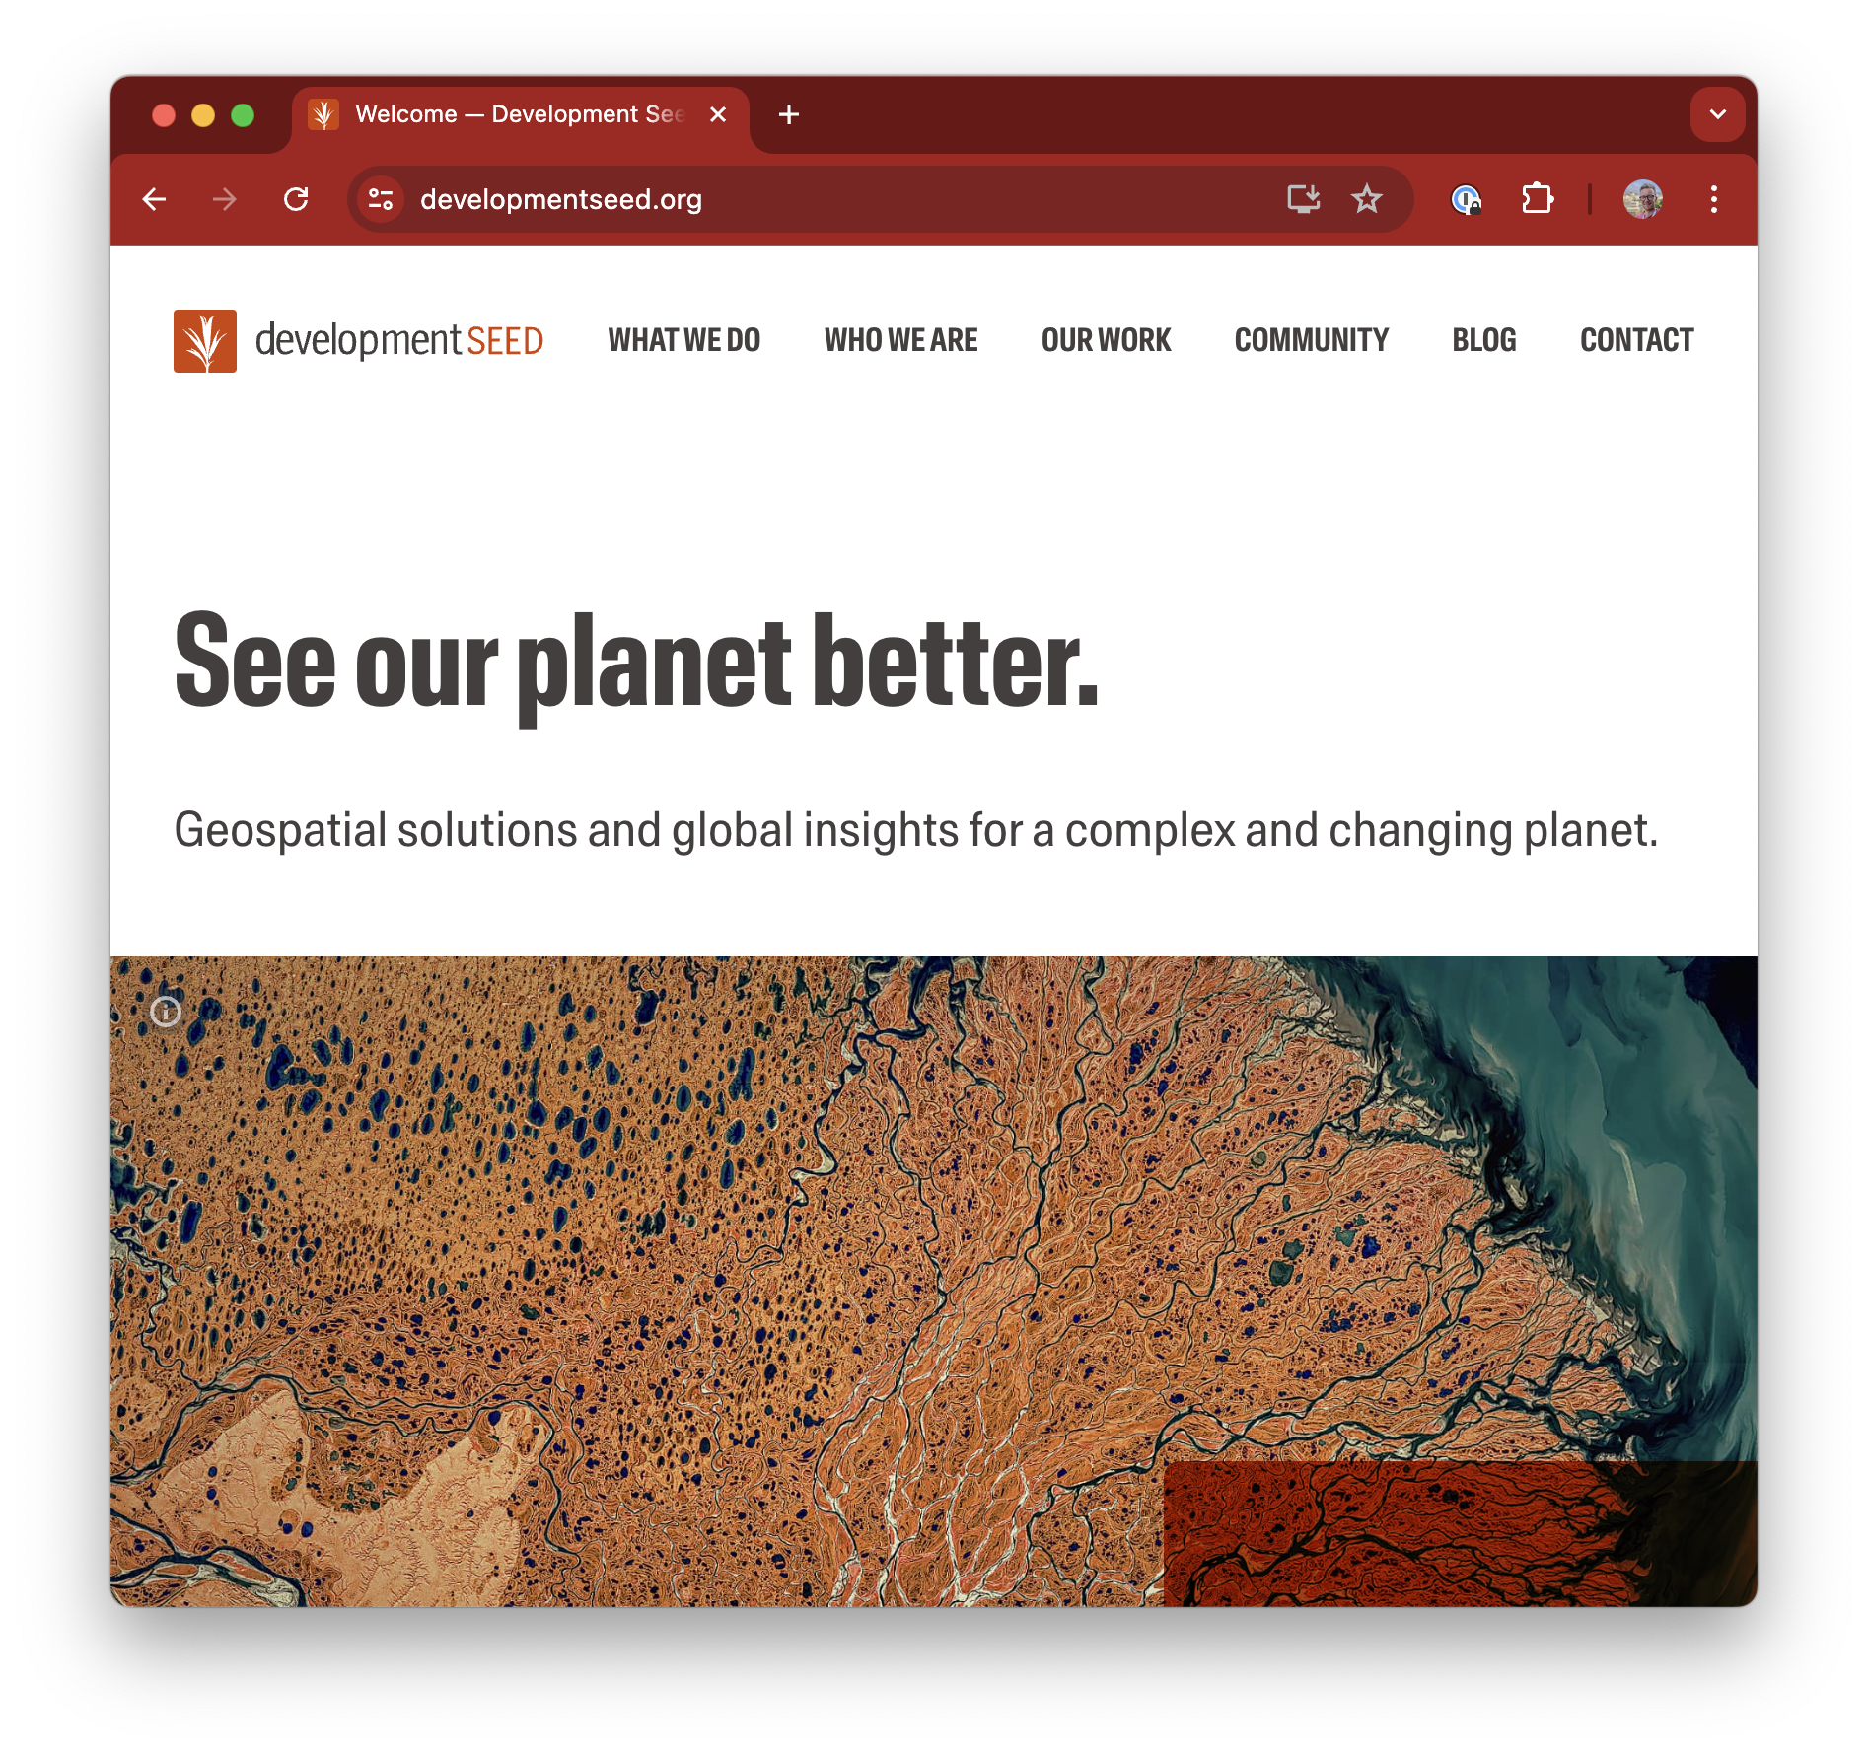
Fast forward a few years
Joined Development Seed: open-source geospatial services
Had some R&D time to explore…
Geospatial data visualization
Interactive computing
Broad accessibility
Data interoperability
Binary data representation
Fast, compiled code

Slide 11
Simpler, faster rendering of large analytical vector datasets (in Python)

Slide 12
…why not existing libraries?

Slide 13
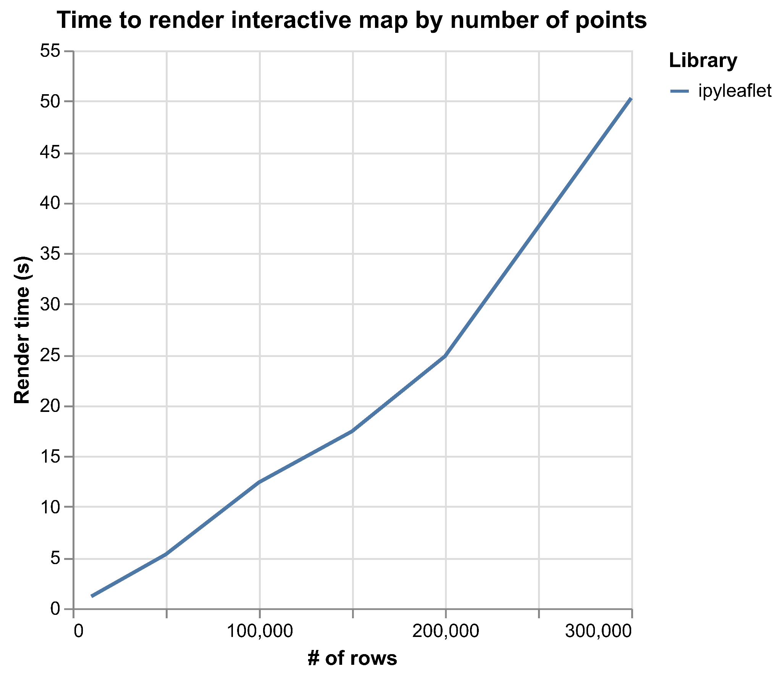
ipyleaflet?
Notes:
Failed at 400,000 points

Slide 14
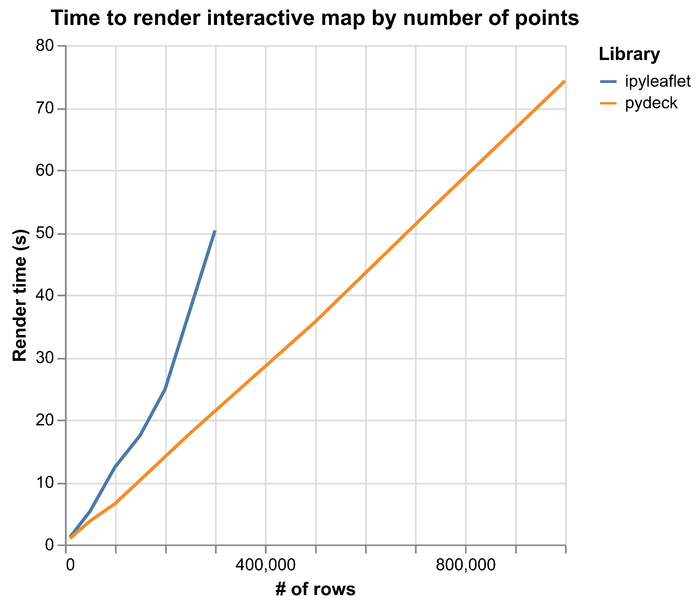
pydeck?
Notes:
Powered by deck.gl on the GPU
Failed at 1.2 million points (after 90 seconds)

Slide 15
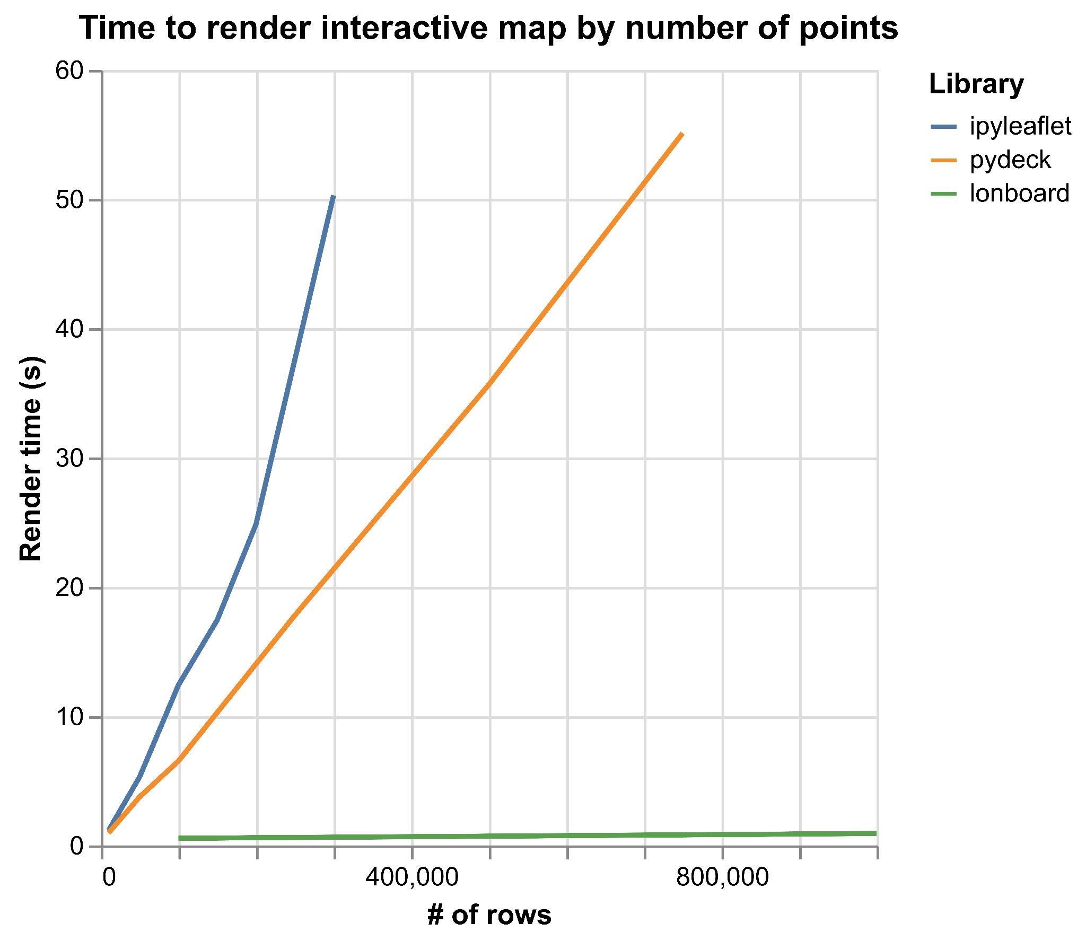
lonboard!
Notes:
Failed at 1.2 million points (after 90 seconds)

Slide 16
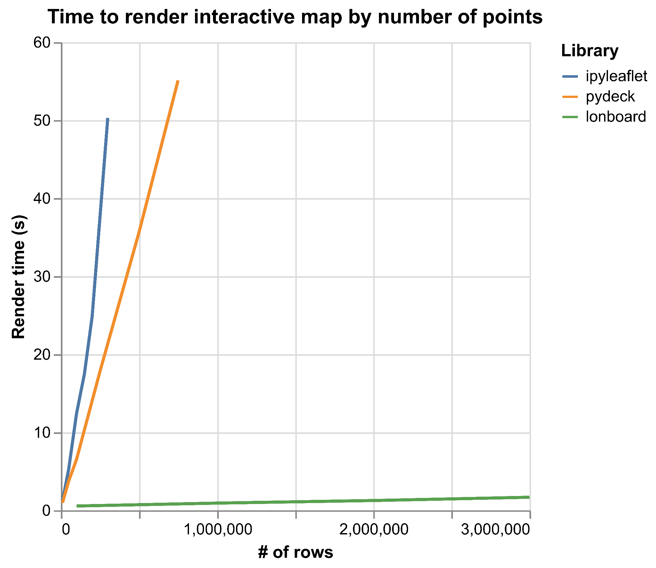
lonboard!
Notes:
Failed at 1.2 million points (after 90 seconds)

Slide 17
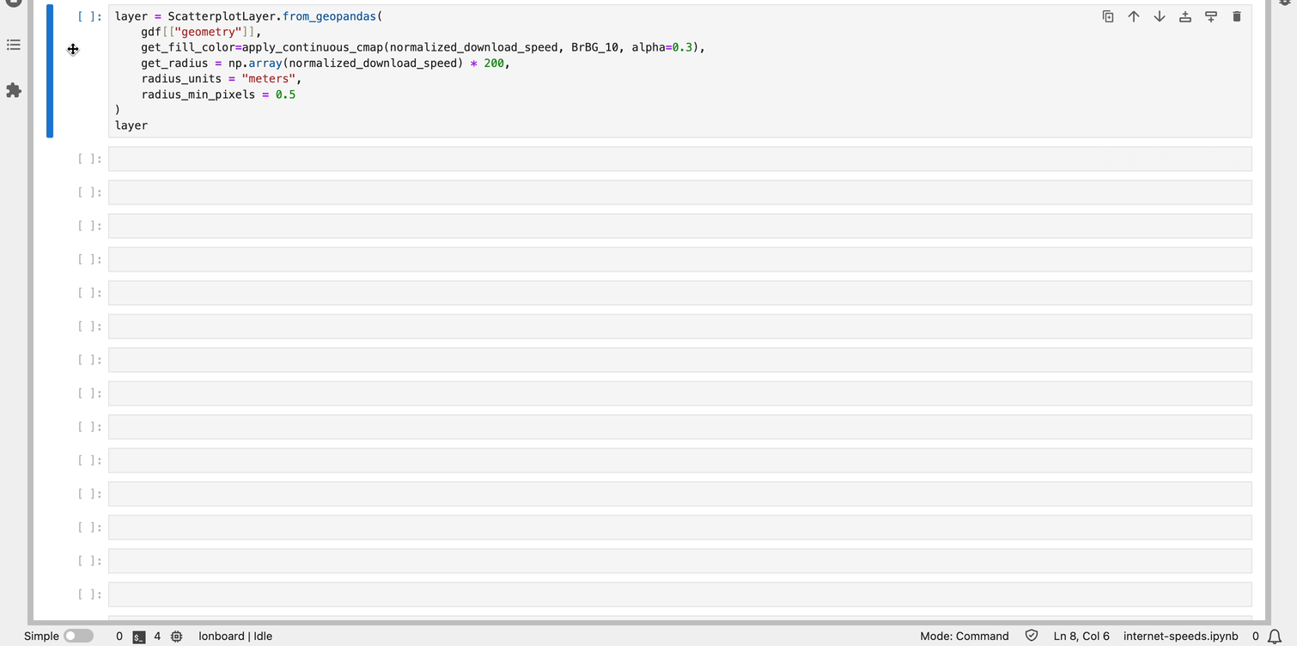
Lonboard: 3 million points in 2.5 seconds

Slide 18
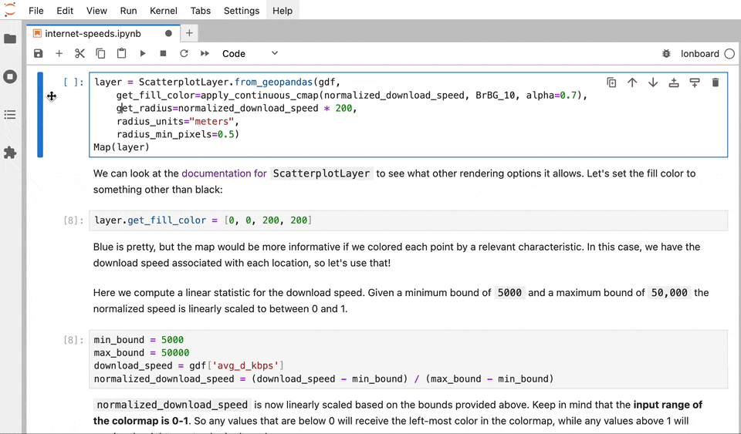
Interactive Data Exploration

Slide 19
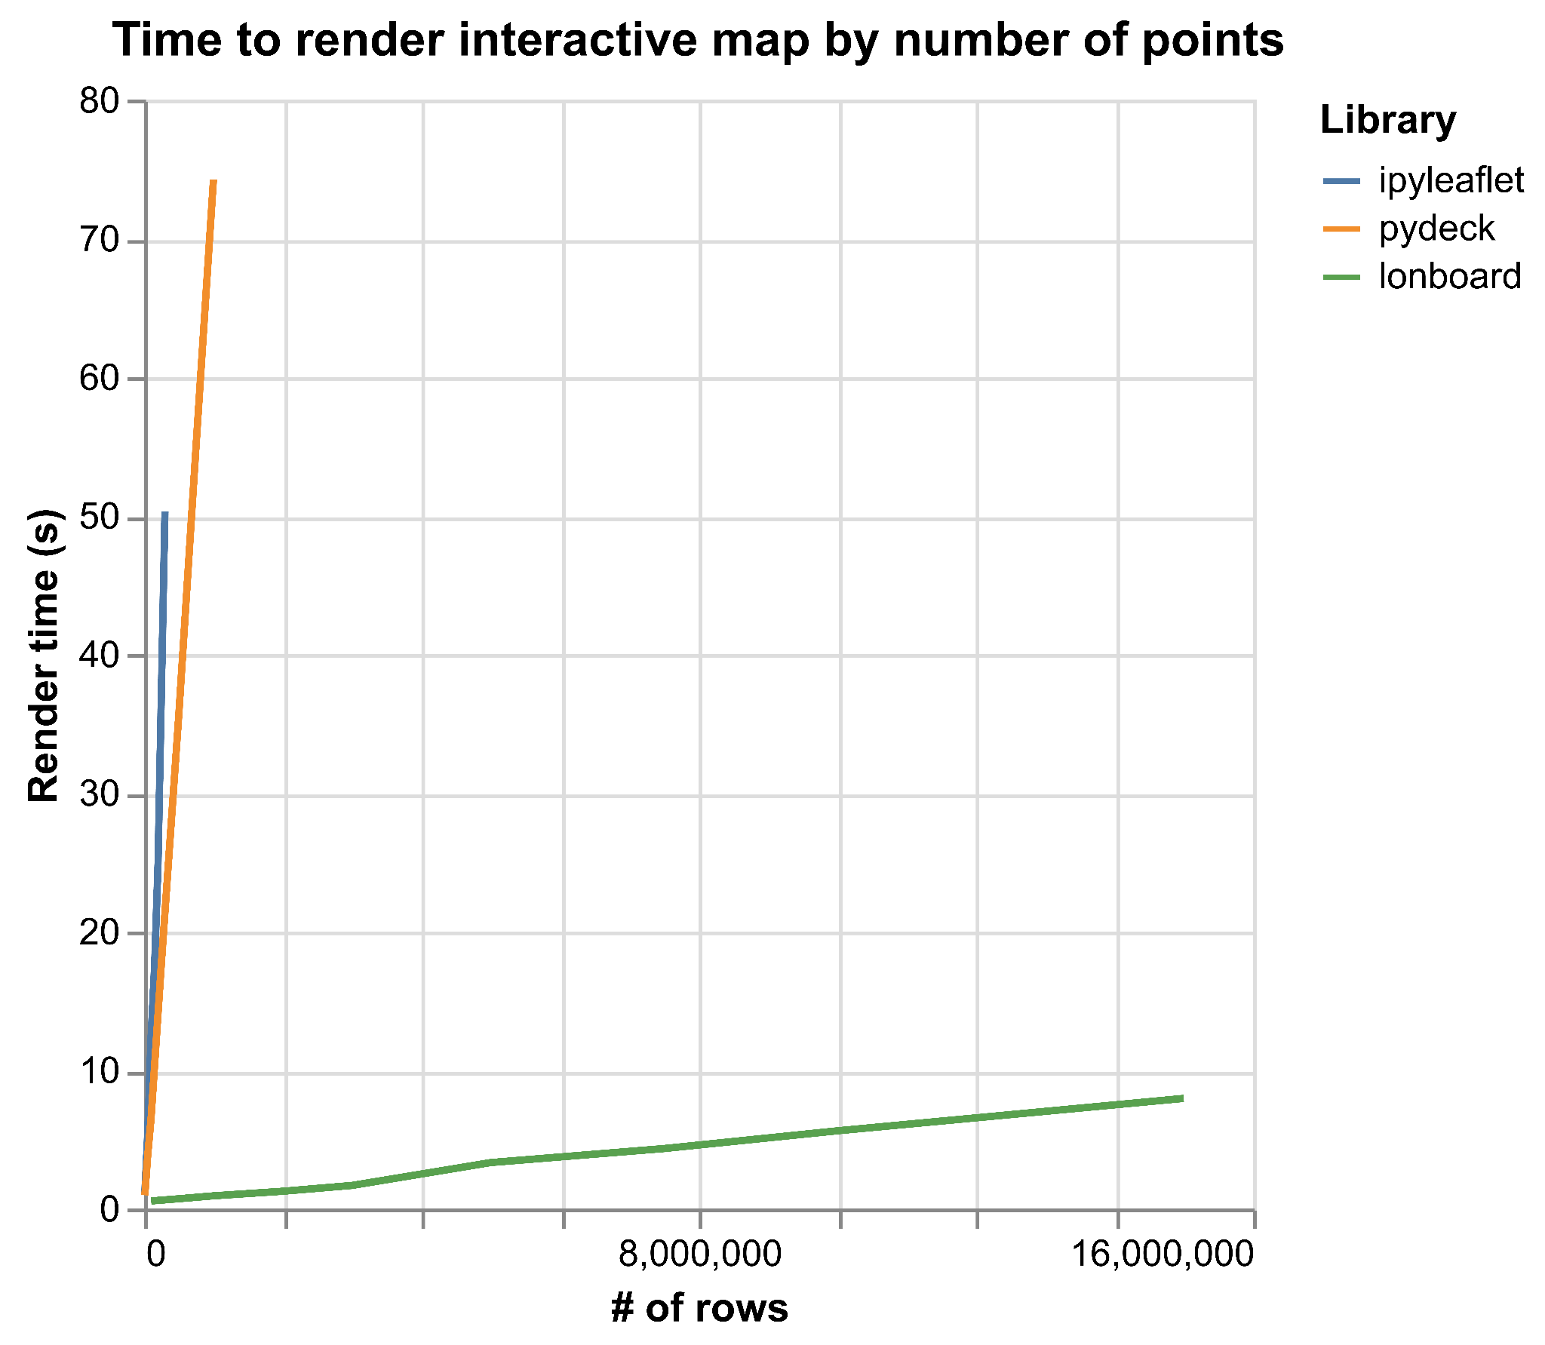
lonboard!
Notes:
Rendered 10 million points in the time it took ipyleaflet to render 50,000 points
Rendered 15 million points

Slide 20
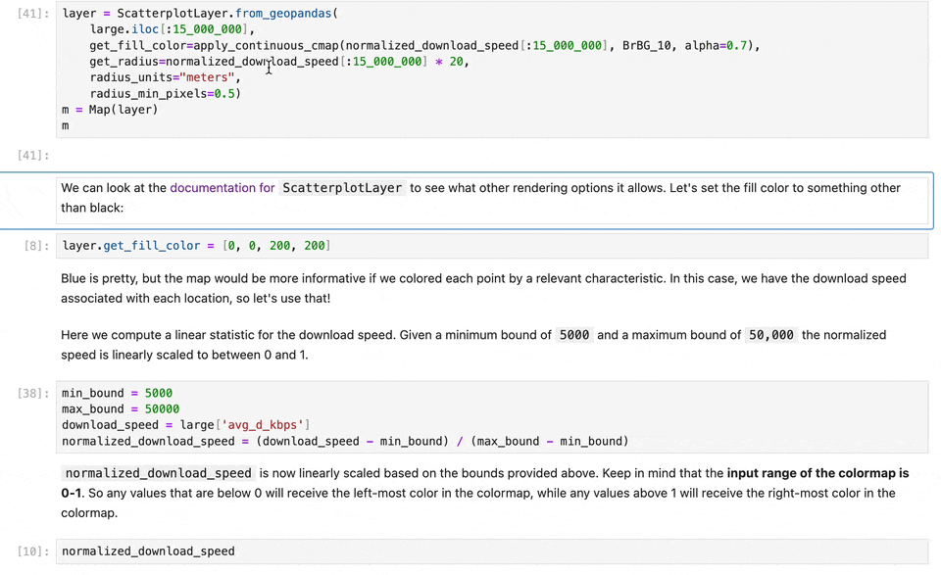
Laggy, but functional at 15M points

Slide 21
High-level API & integrations

Slide 22
Simple to use
Lonboard integrates with existing libraries
GeoPandas GeoDataFrame, GeoSeries
Shapely array, scalar
DuckDB Spatial query
GDAL (pyogrio)
Ibis (in progress)
Any GeoArrow Python object

Slide 23
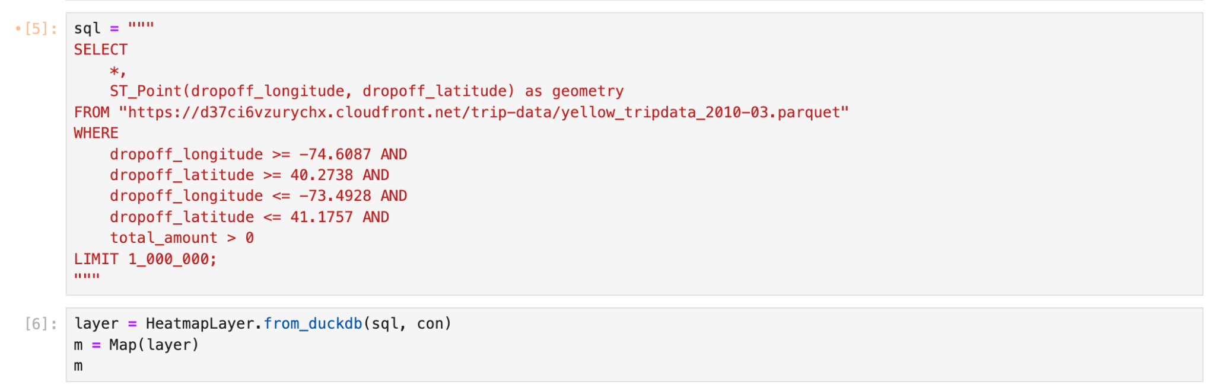
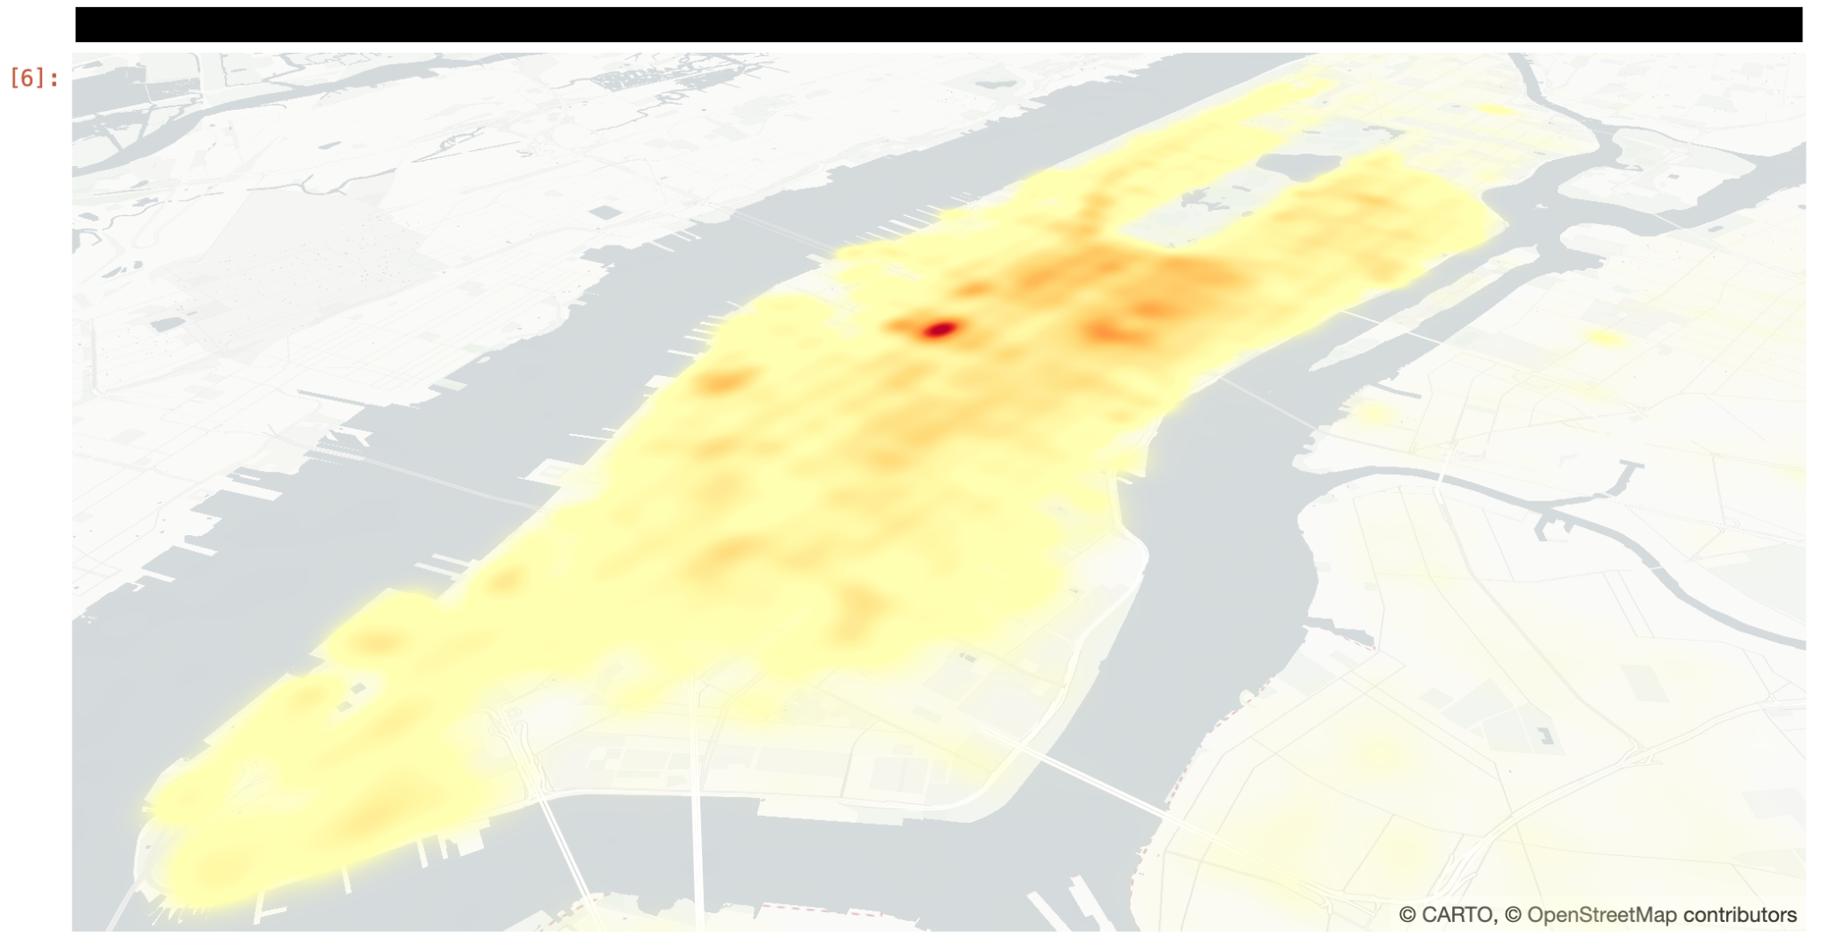
High-level API
DuckDB Integration
Pass query into from_duckdb

Slide 24
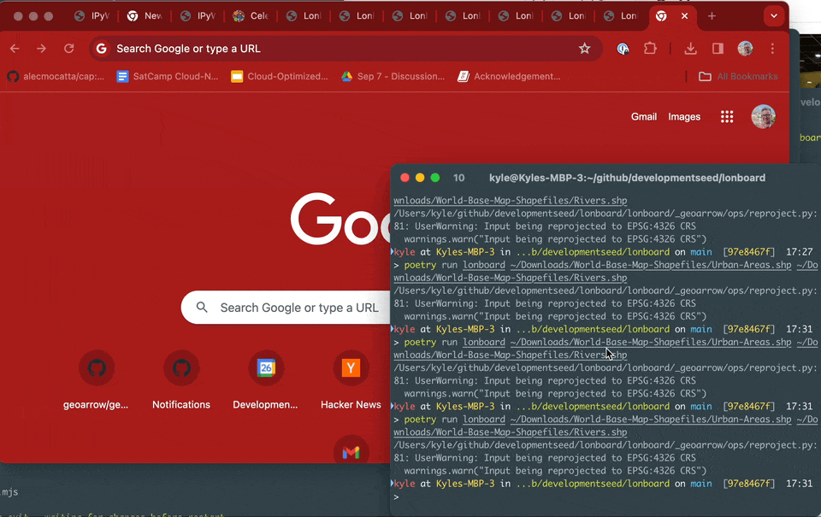
High-level API
CLI Included

Slide 25
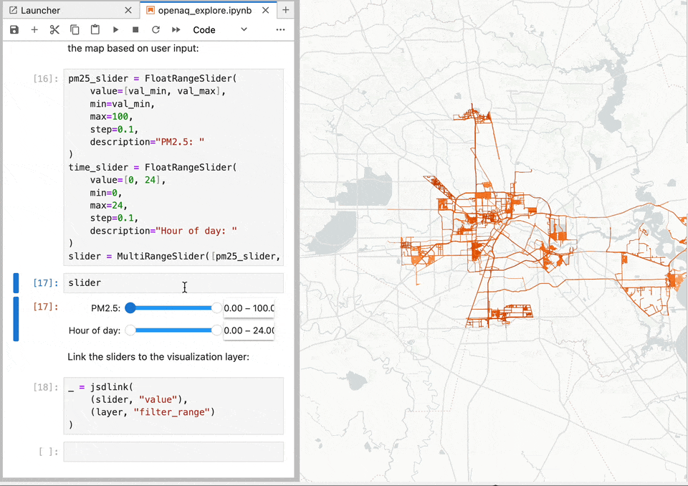
GPU Data Filtering

Slide 26
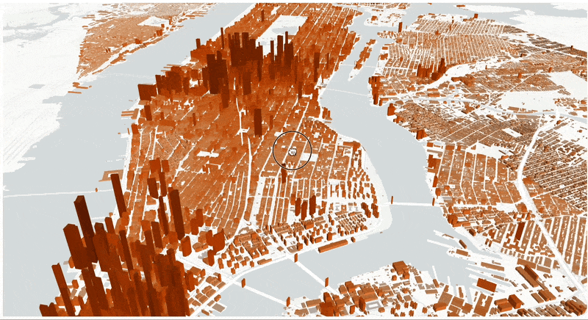
Buildings data

Slide 27
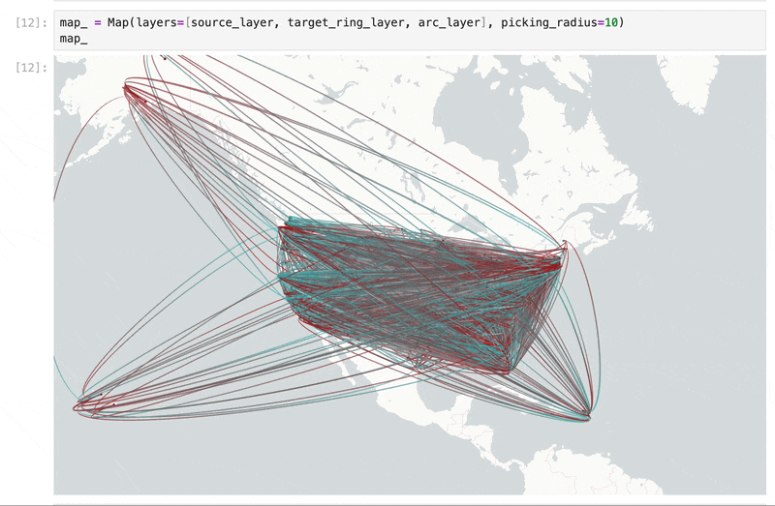
County-to-County Migration

Slide 28
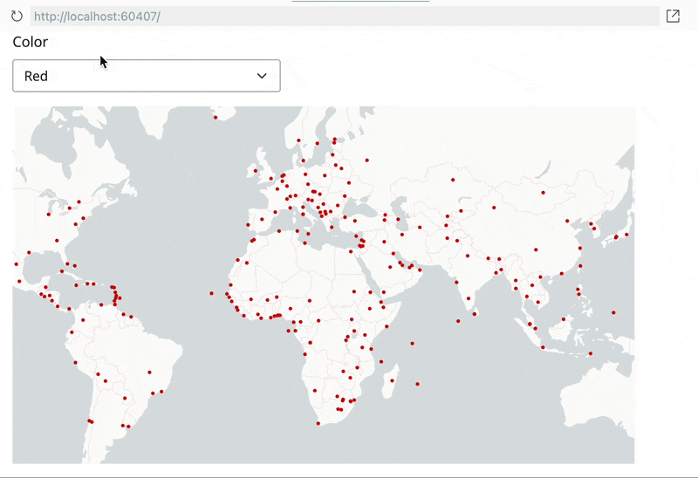
Dashboard integration
e.g. Shiny, Panel

Slide 29

What’s in a name?
A "deck" is the part of a skateboard you ride on. What's a fast, geospatial skateboard?
A lonboard.
Credit Kiri Carini & Dall-E & internet skateboarders’ training data

Slide 30
Demos

Slide 31
How is it so fast?

Slide 32
Data rendering on the web
Three parts of vector web maps
Load data to the browser
Manage data in memory
Render to screen
Notes:
A crucial part of this talk is JavaScript and the browser, because if you want to have interactivity, you need to use the browser.

Slide 33
Data rendering on the web
Three parts of vector web maps (slow)
Load data to the browser
Manage data in memory
Render to screen
GeoJSON
Massive file size
Very slow to read and write
No partial reads
GeoJSON-like JavaScript objects
Memory overhead
Can’t be shared with web worker or WebAssembly
High garbage collector overhead (many small JavaScript array objects)
Leaflet
Slow to iterate over input features and render to HTML canvas element

Slide 34
Binary data pipelines are fast
Three parts of vector web maps (fast)
Load data to the browser
Manage data in memory
Render to screen
GeoParquet
Fastest way to move data
Efficient compression
Spatial/column selection
Very fast to read and write
parquet-wasm in WebAssembly
GeoArrow
Most efficient way to represent geospatial DataFrames
Binary buffers store entire column’s data
No serialization to share with web worker or WebAssembly
No garbage collector overhead
deck.gl
Fastest analytical map rendering on the web
Copy directly from GeoArrow memory to the GPU
Instanced (vectorized) draw calls
Notes:
Enabled by both server & client advancements
Each part minimizes bottleneck

Slide 35
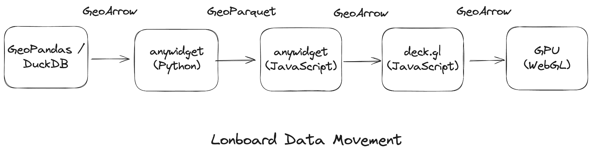
End-to-end binary data pipeline
Notes:
GPU doesn’t matter if you’re CPU-limited
GeoArrow & GeoParquet throughout the data pipeline.
Python: GeoPandas to GeoArrow to Parquet.
Transfer compressed binary buffers to the Browser.
JavaScript: Decode Parquet to GeoArrow.
deck.gl: Pass GeoArrow buffers to the GPU.

Slide 36
Lonboard’s ulterior motive

Slide 37
Lonboard’s ulterior motive:
Establish a GeoArrow ecosystem

Slide 38
A fast data protocol for geospatial data

Slide 39
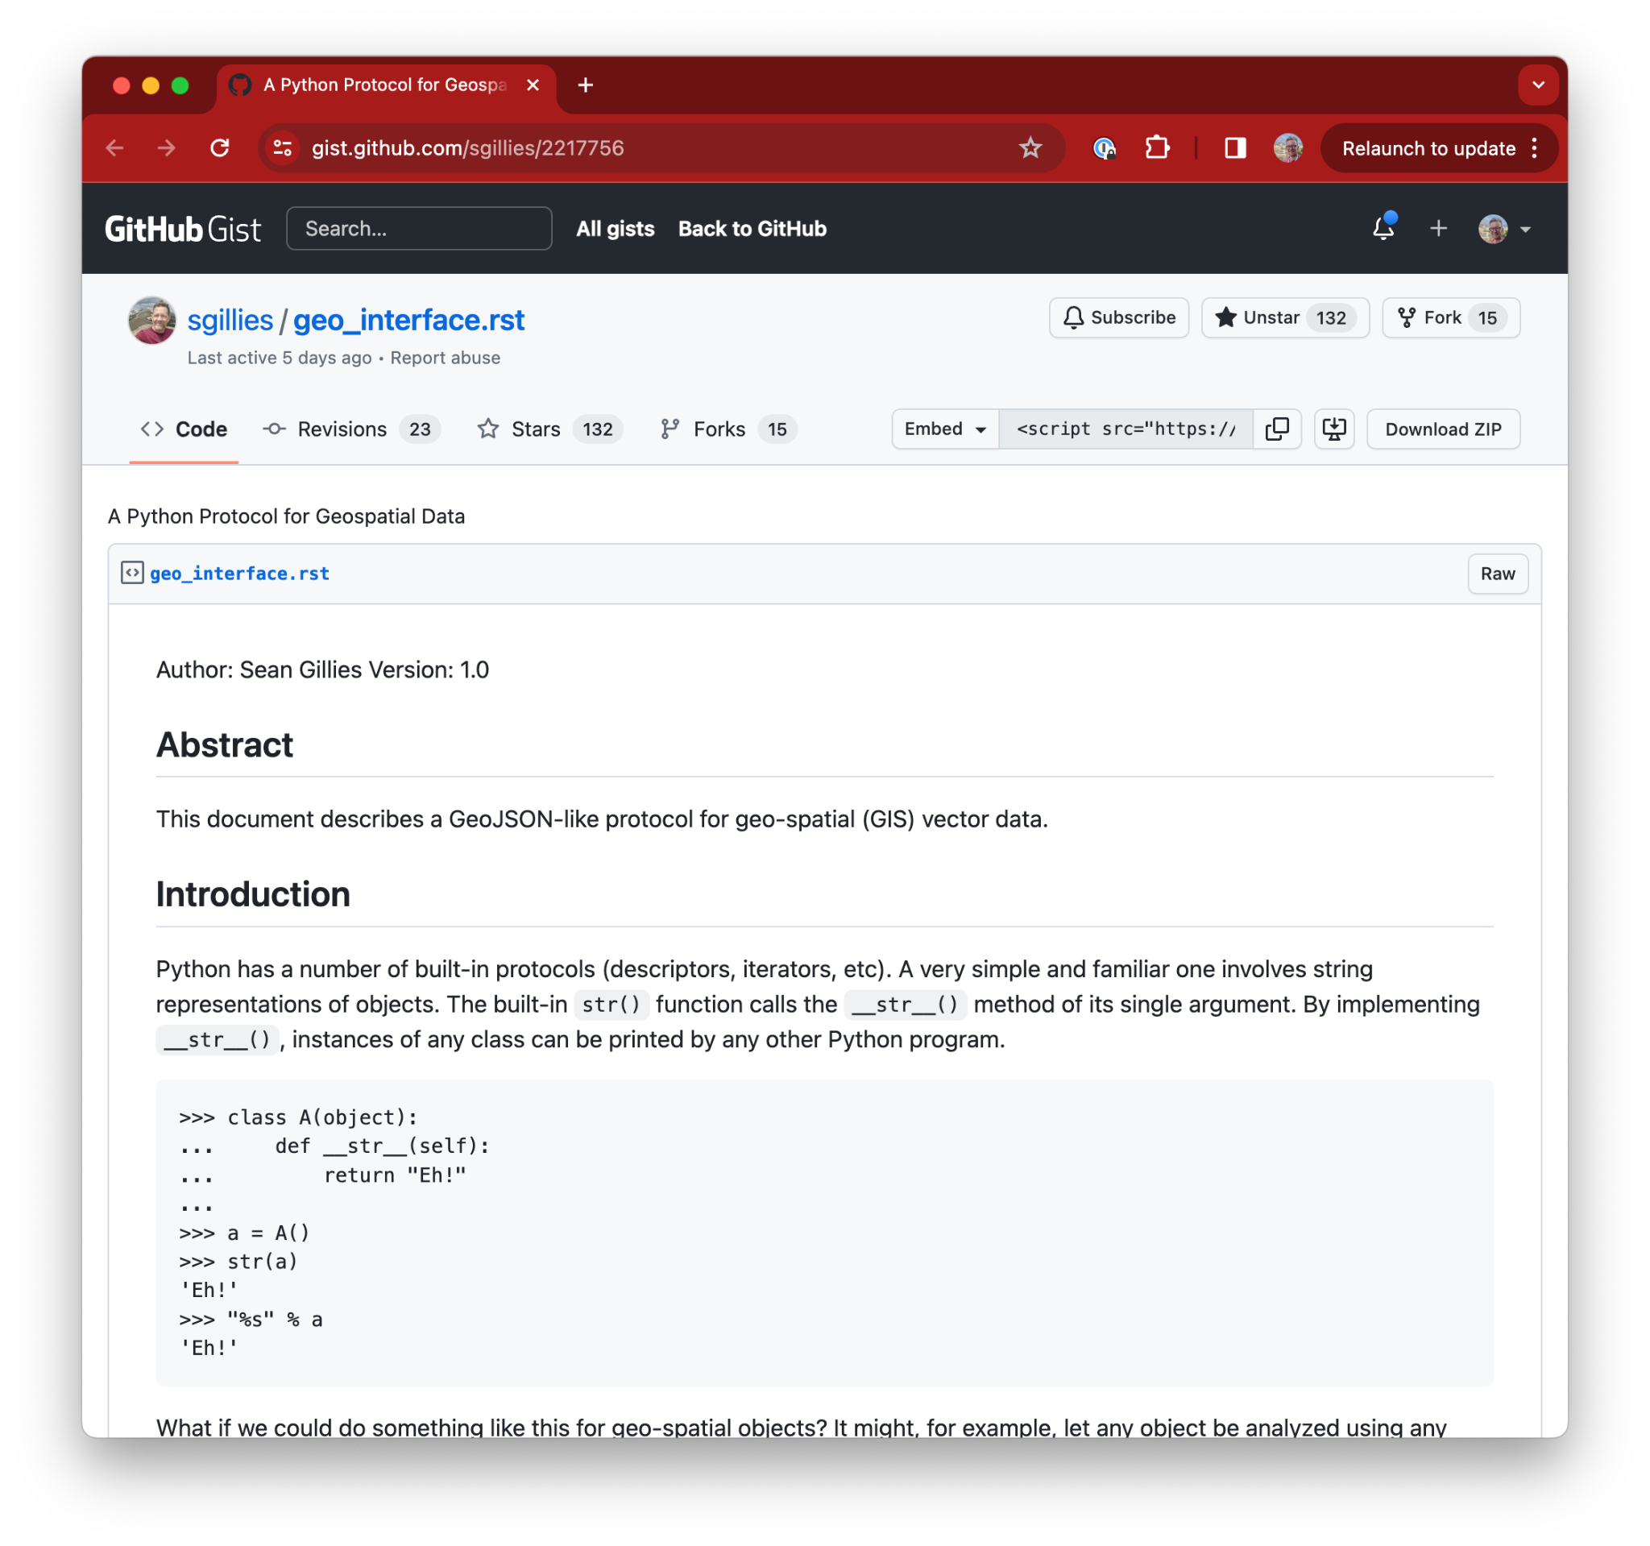
Data what?
Data protocols “unlink” the producer and consumer of data
No knowledge of each other needed
Python: Geo Interface protocol
A __geo_interface__ attribute gives you GeoJSON.
v1.0 in March 2012

Slide 40
Data protocols enable innovation
A __geo_interface__ attribute gives you GeoJSON.
Many more implementations. (unknown number!)
All of these libraries just work together.
A new library can connect to a full ecosystem by implementing a single interface
GeoPandas | traffic | fastkml | ArcPy
pyproj | geojson | mapnik | descartes
Shapely | Fiona | PySAL | geojson
PySHP | gdal | lonboard | ezdxf
Selected libraries implementing __geo_interface__

Slide 41
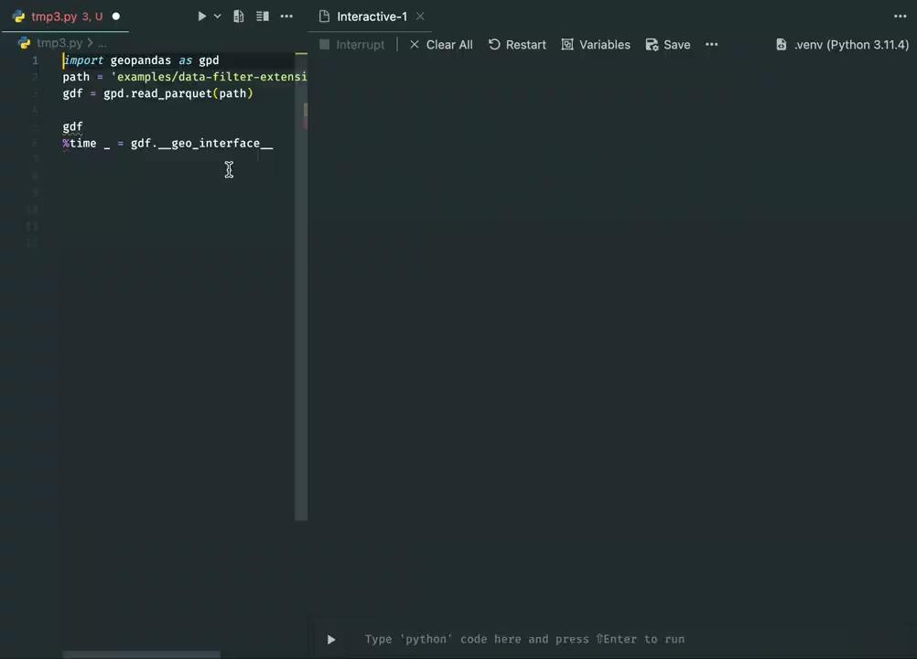
Problem Solved…?
Format of the data protocol very different than internal representation
Calling __geo_interface__ triggers data transformation
Overhead for both producer & consumer
GeoJSON not efficient to operate on, so libraries don’t store it directly
1 minute overhead on 3 million point dataset

Slide 42
Fast data protocols enable innovation

Slide 43
Enabling zero-copy data sharing for scientific Python libraries
Python Buffer Protocol (2006)
“This cannot be emphasized enough: it is fundamentally the Buffer Protocol and related NumPy functionality that make Python useful as a scientific computing platform.”
Problem: Expensive to copy & convert array data between Python libraries
Binary protocol for array data
Enabled widespread innovation on top of NumPy (v1.0 in 2006)
– JAKE VANDERPLAS (An Introduction to the Python Buffer Protocol)
https://jakevdp.github.io/blog/2014/05/05/introduction-to-the-python-buffer-protocol/

Slide 44
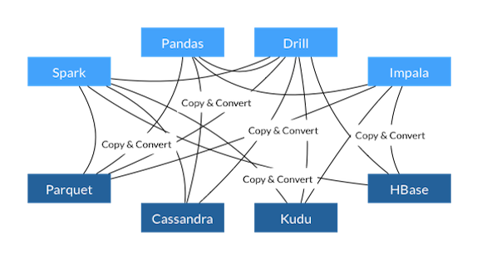
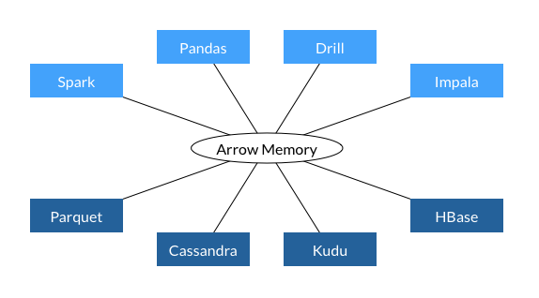
Before Arrow
Binary data protocol for tabular data
Apache Arrow (2015)
With Arrow
Problem: Expensive to copy & convert tabular data between libraries (e.g. Pandas) and languages (e.g. Python - R)
Binary data protocol for tabular data.
Language-independent, zero-copy data sharing

Slide 45
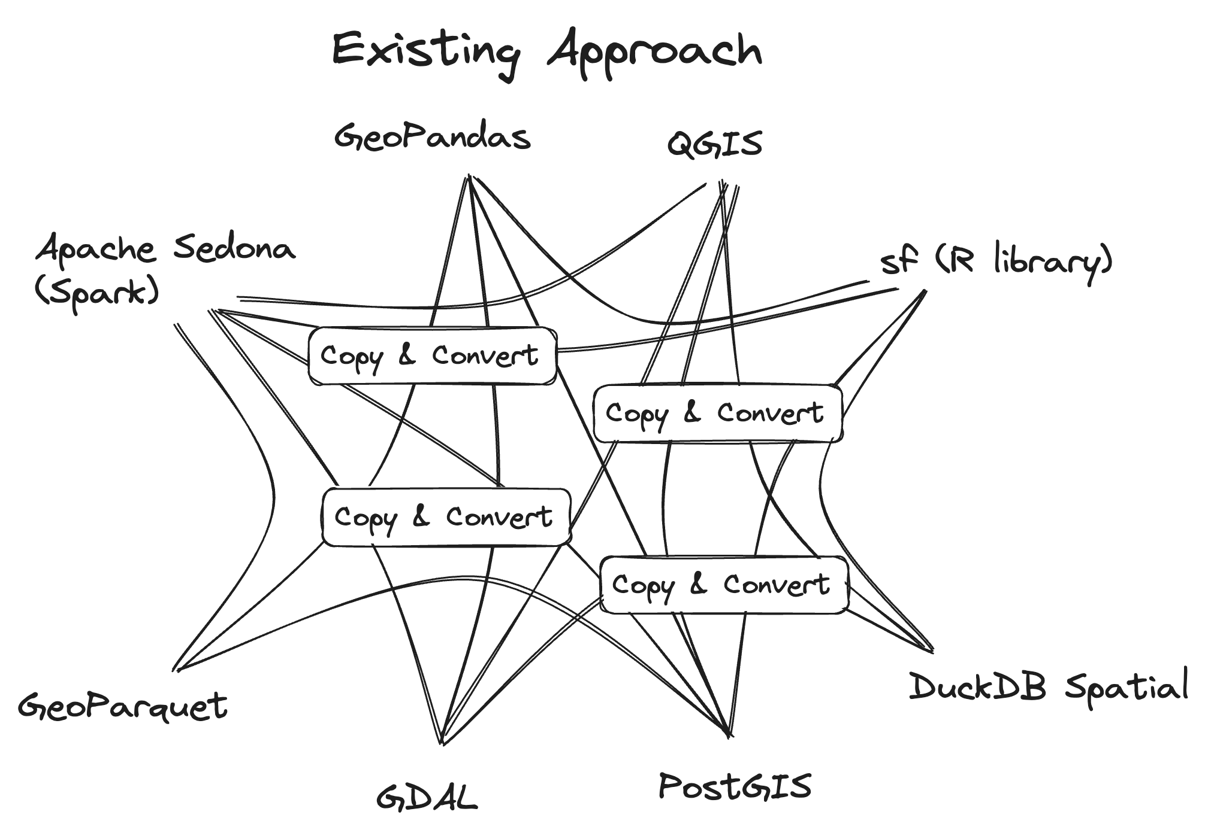
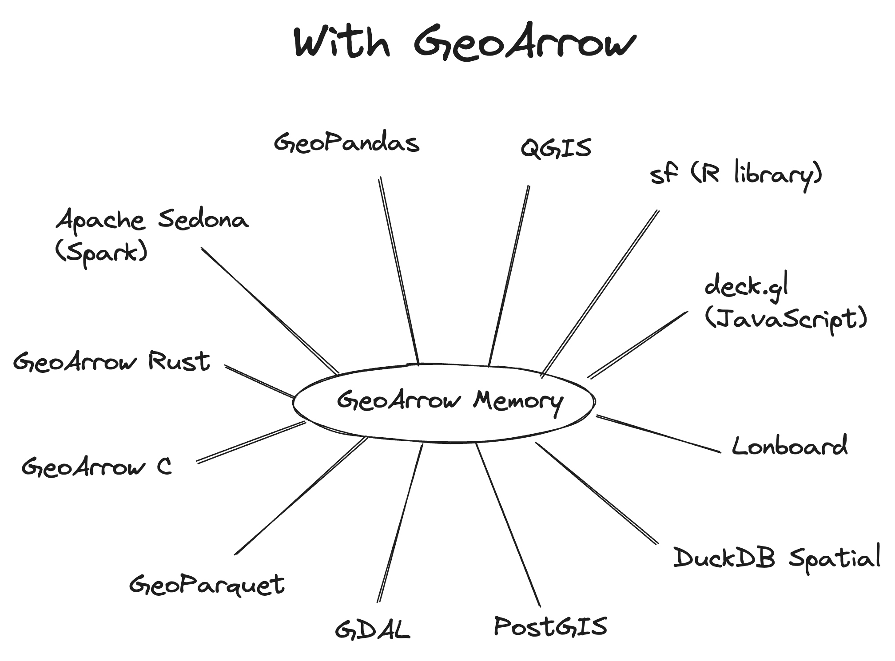
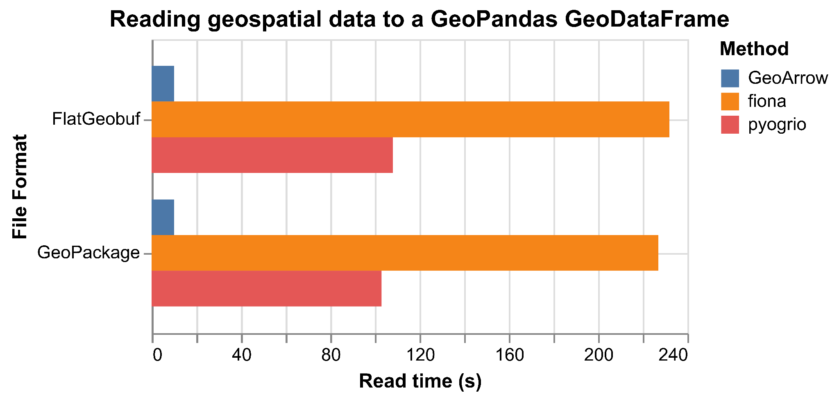
Enabling zero-copy data sharing for geospatial
GeoArrow (2020)
Problem: Expensive to copy & convert geospatial tabular data between libraries and languages
Binary data protocol for geospatial tabular data.
Language-independent, zero-copy data sharing

Slide 46
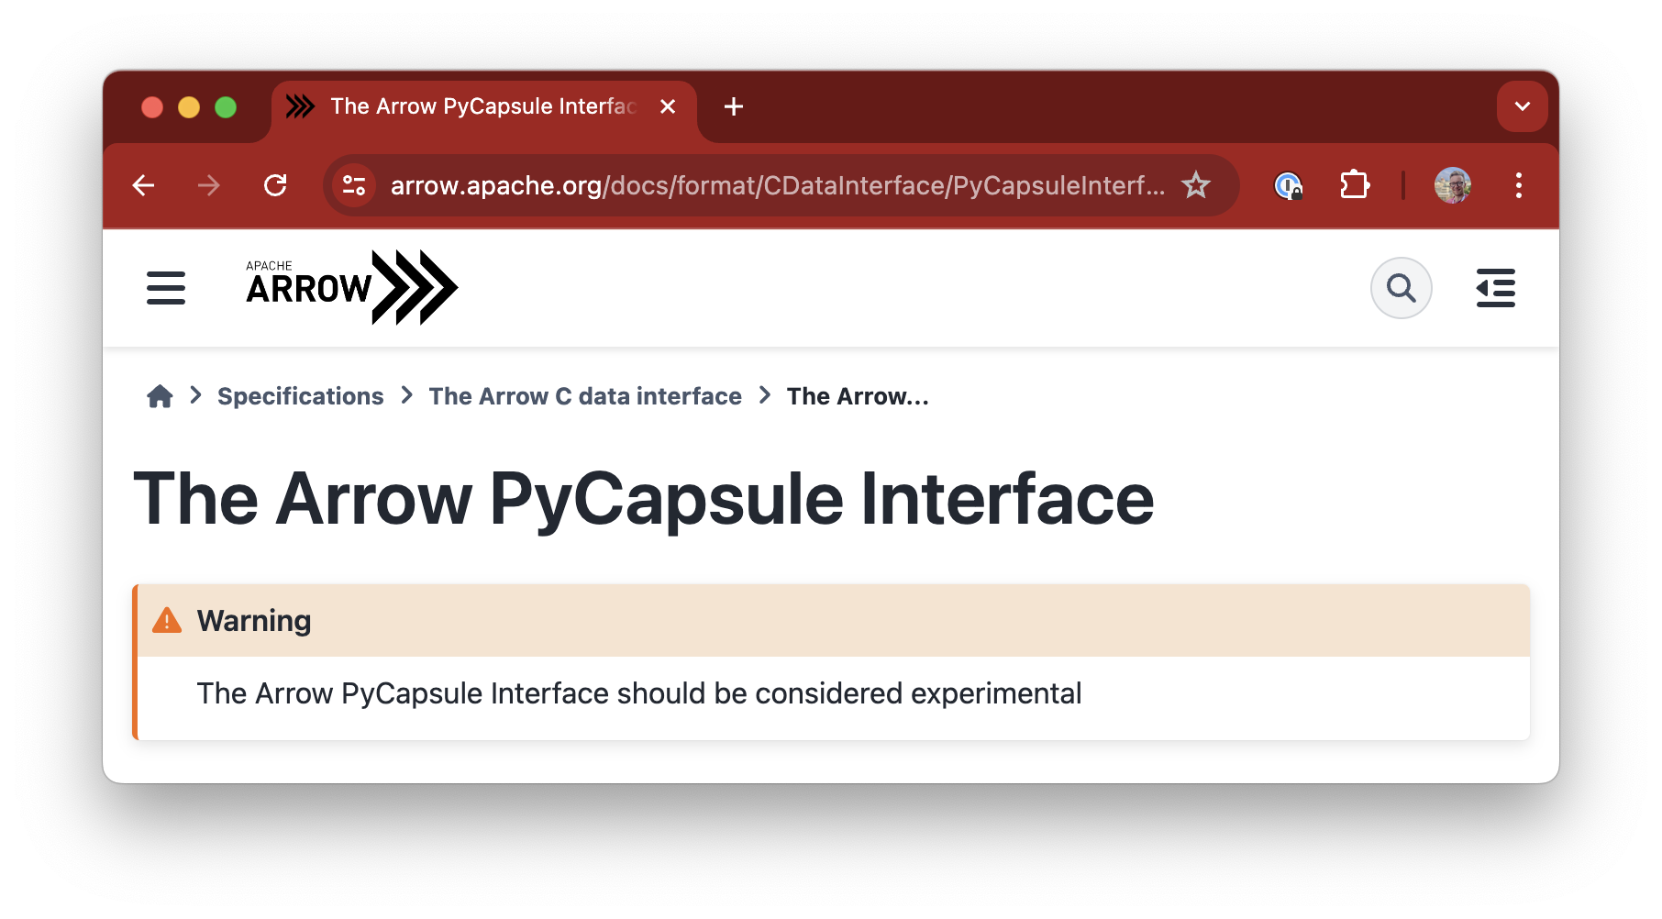
Enabling zero-copy data sharing across Python libraries
Arrow PyCapsule Interface (2023)
Python protocol for zero-copy sharing of Arrow data
Arrow itself is just a format; this interface describes how Python packages should expose/ingest that format
Works for Arrow and GeoArrow out of the box*
Lonboard supports every such library (as long as they provide data with geospatial metadata)
pyarrow | nanoarrow | arro3
pyogrio | gdal | polars
quak | pandas | vegafusion
Selected libraries implementing PyCapsule Interface
fastexcel | daft | lance
datafusion | duckdb | lightgbm
Libraries with open issue for PyCapsule Interface

Slide 47
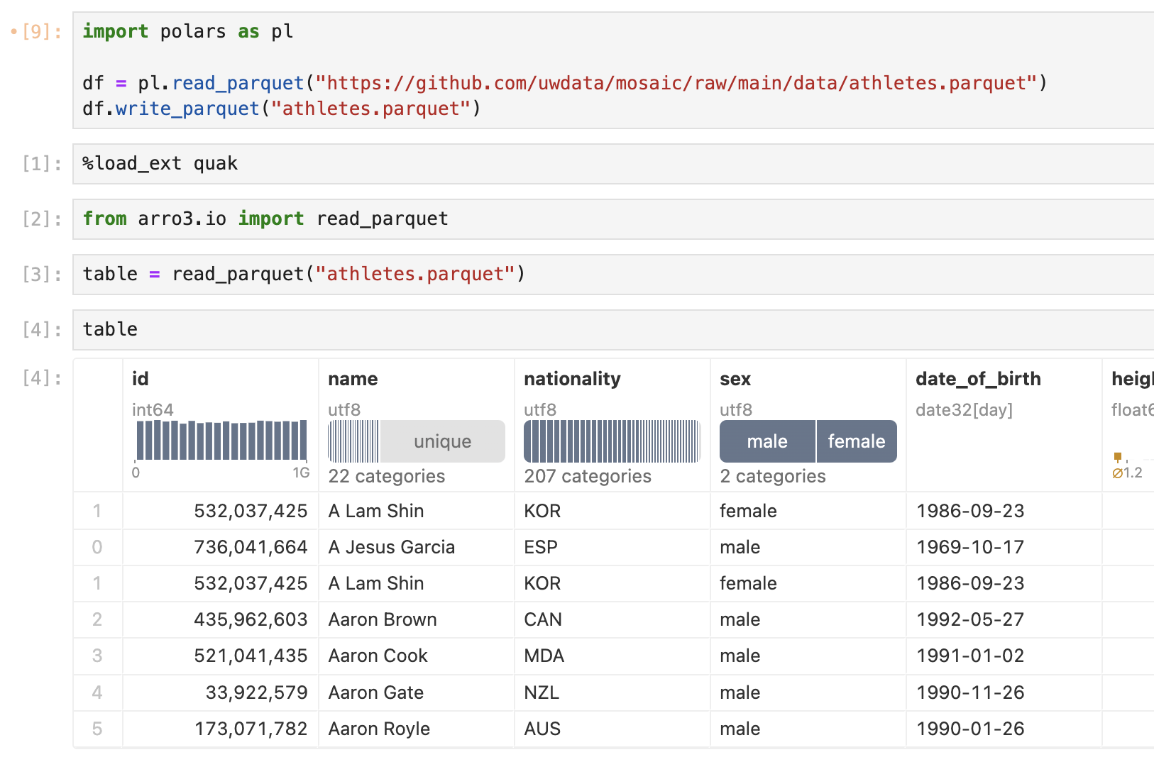
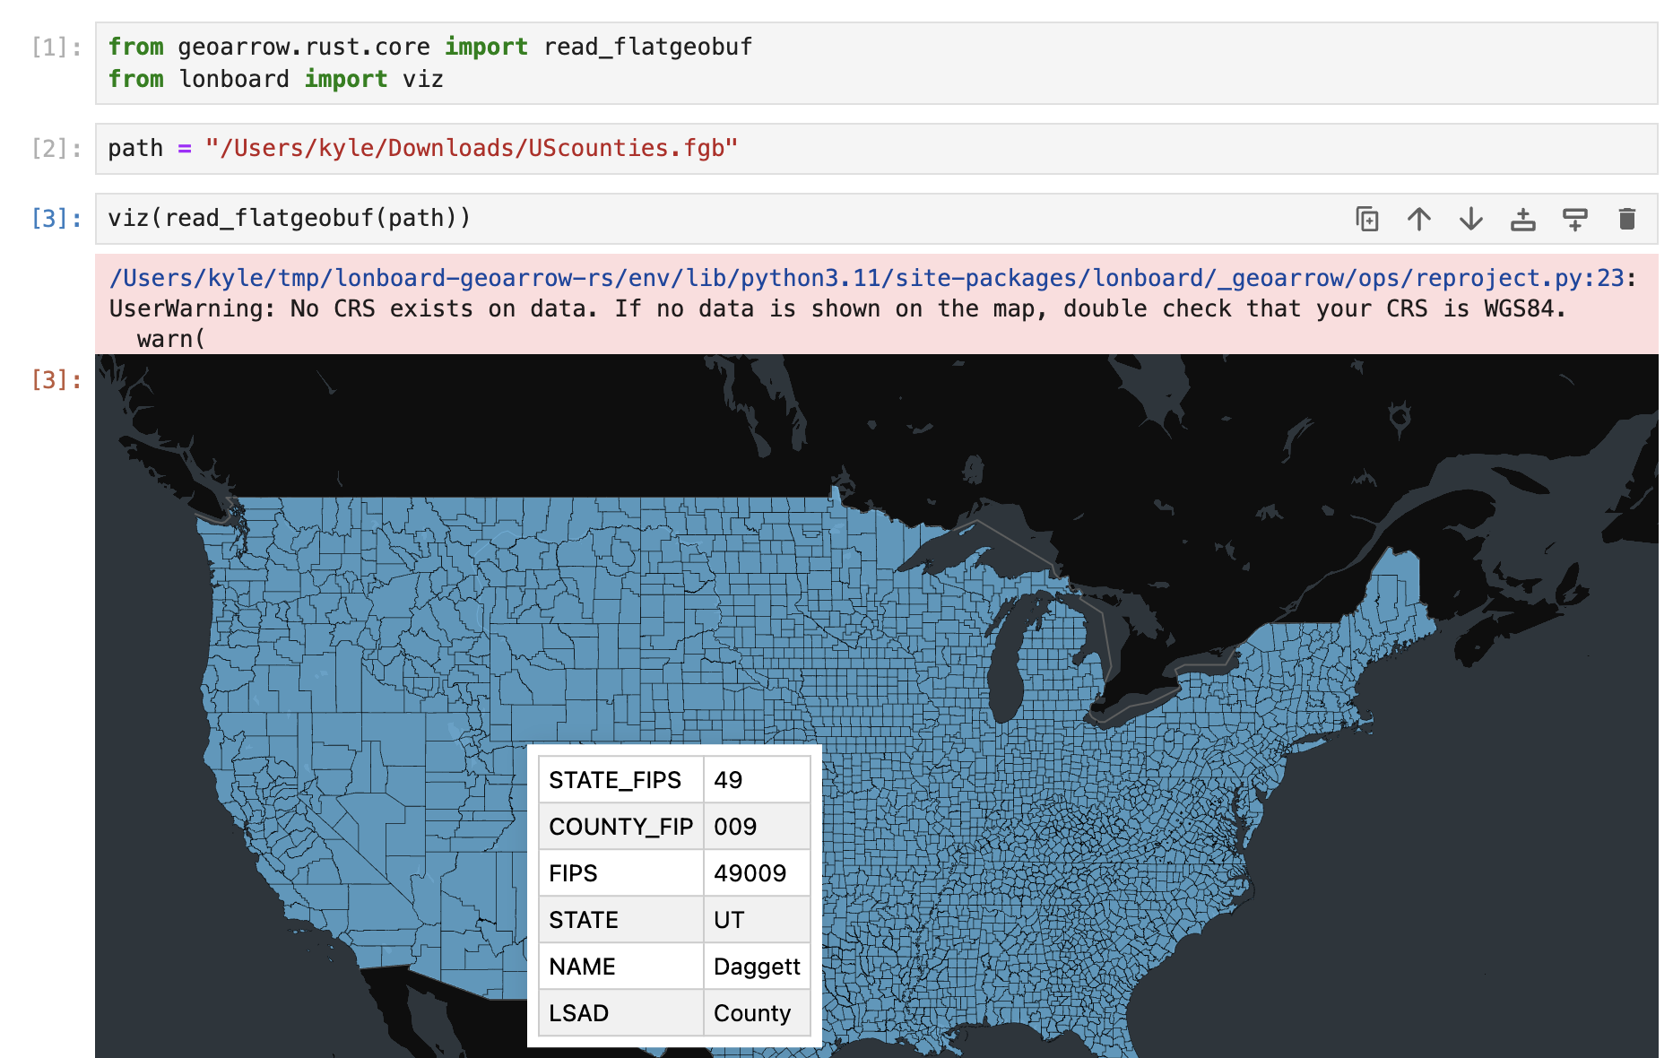
Enabling zero-copy data sharing across Python libraries
Arrow PyCapsule Interface (2023)
quak: a scalable data profiler
Python protocol for zero-copy sharing of Arrow data
Arrow itself is just a format; this interface describes how Python packages should expose/ingest that format
Works for Arrow and GeoArrow out of the box*
Lonboard supports every such library (as long as they provide data with geospatial metadata)

Slide 48
Lonboard: Pushing towards a GeoArrow ecosystem
Lonboard’s end goal: to jumpstart an Arrow-native ecosystem for geospatial data
Ecosystem network effects
If Lonboard is widely used, then more libraries will interface with Arrow
The more libraries built around Arrow, the higher Lonboard’s value

Slide 49
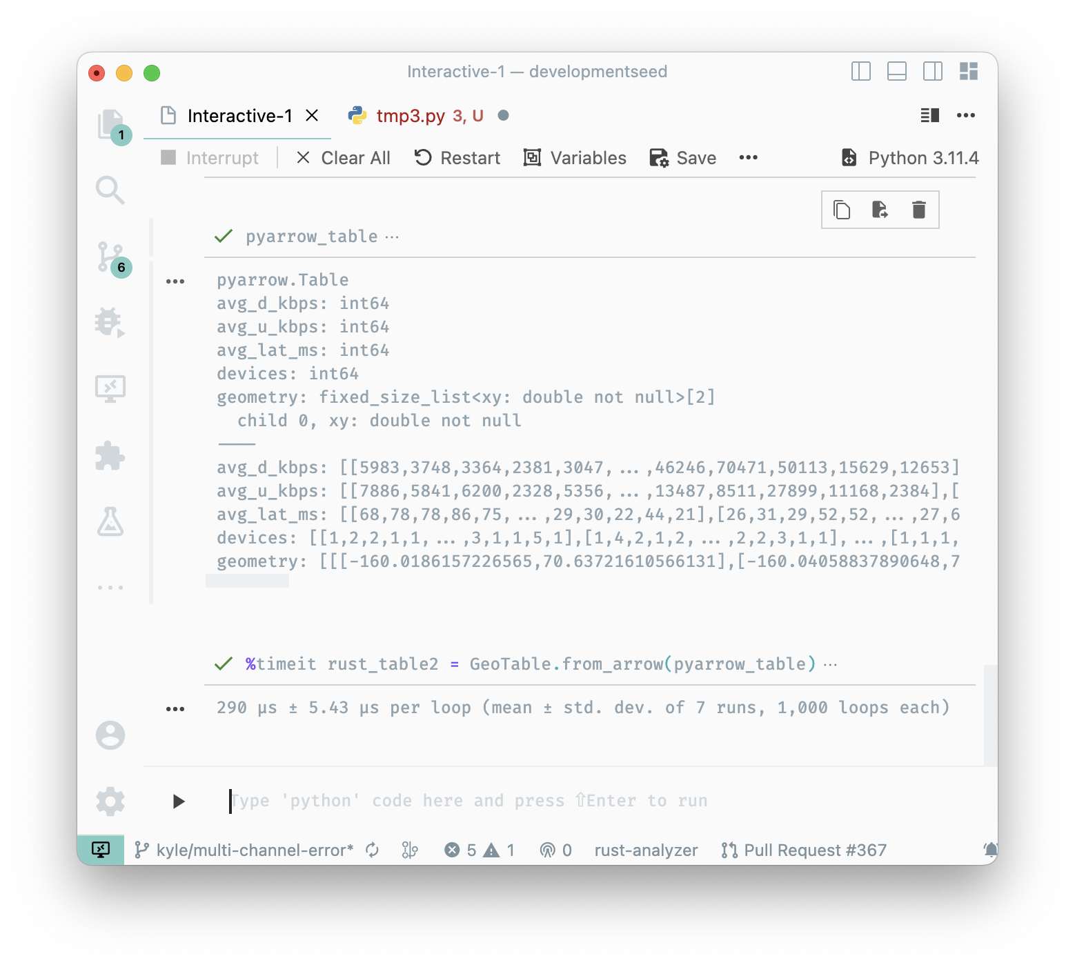
The commoditization of geospatial databases
GeoArrow in Python
Recall the original geo interface example that took 60s
290 microseconds to move data from Python -> Rust
>185,000x faster than __geo_interface__ for this dataset. Even including consuming

Slide 50
Future work

Slide 51
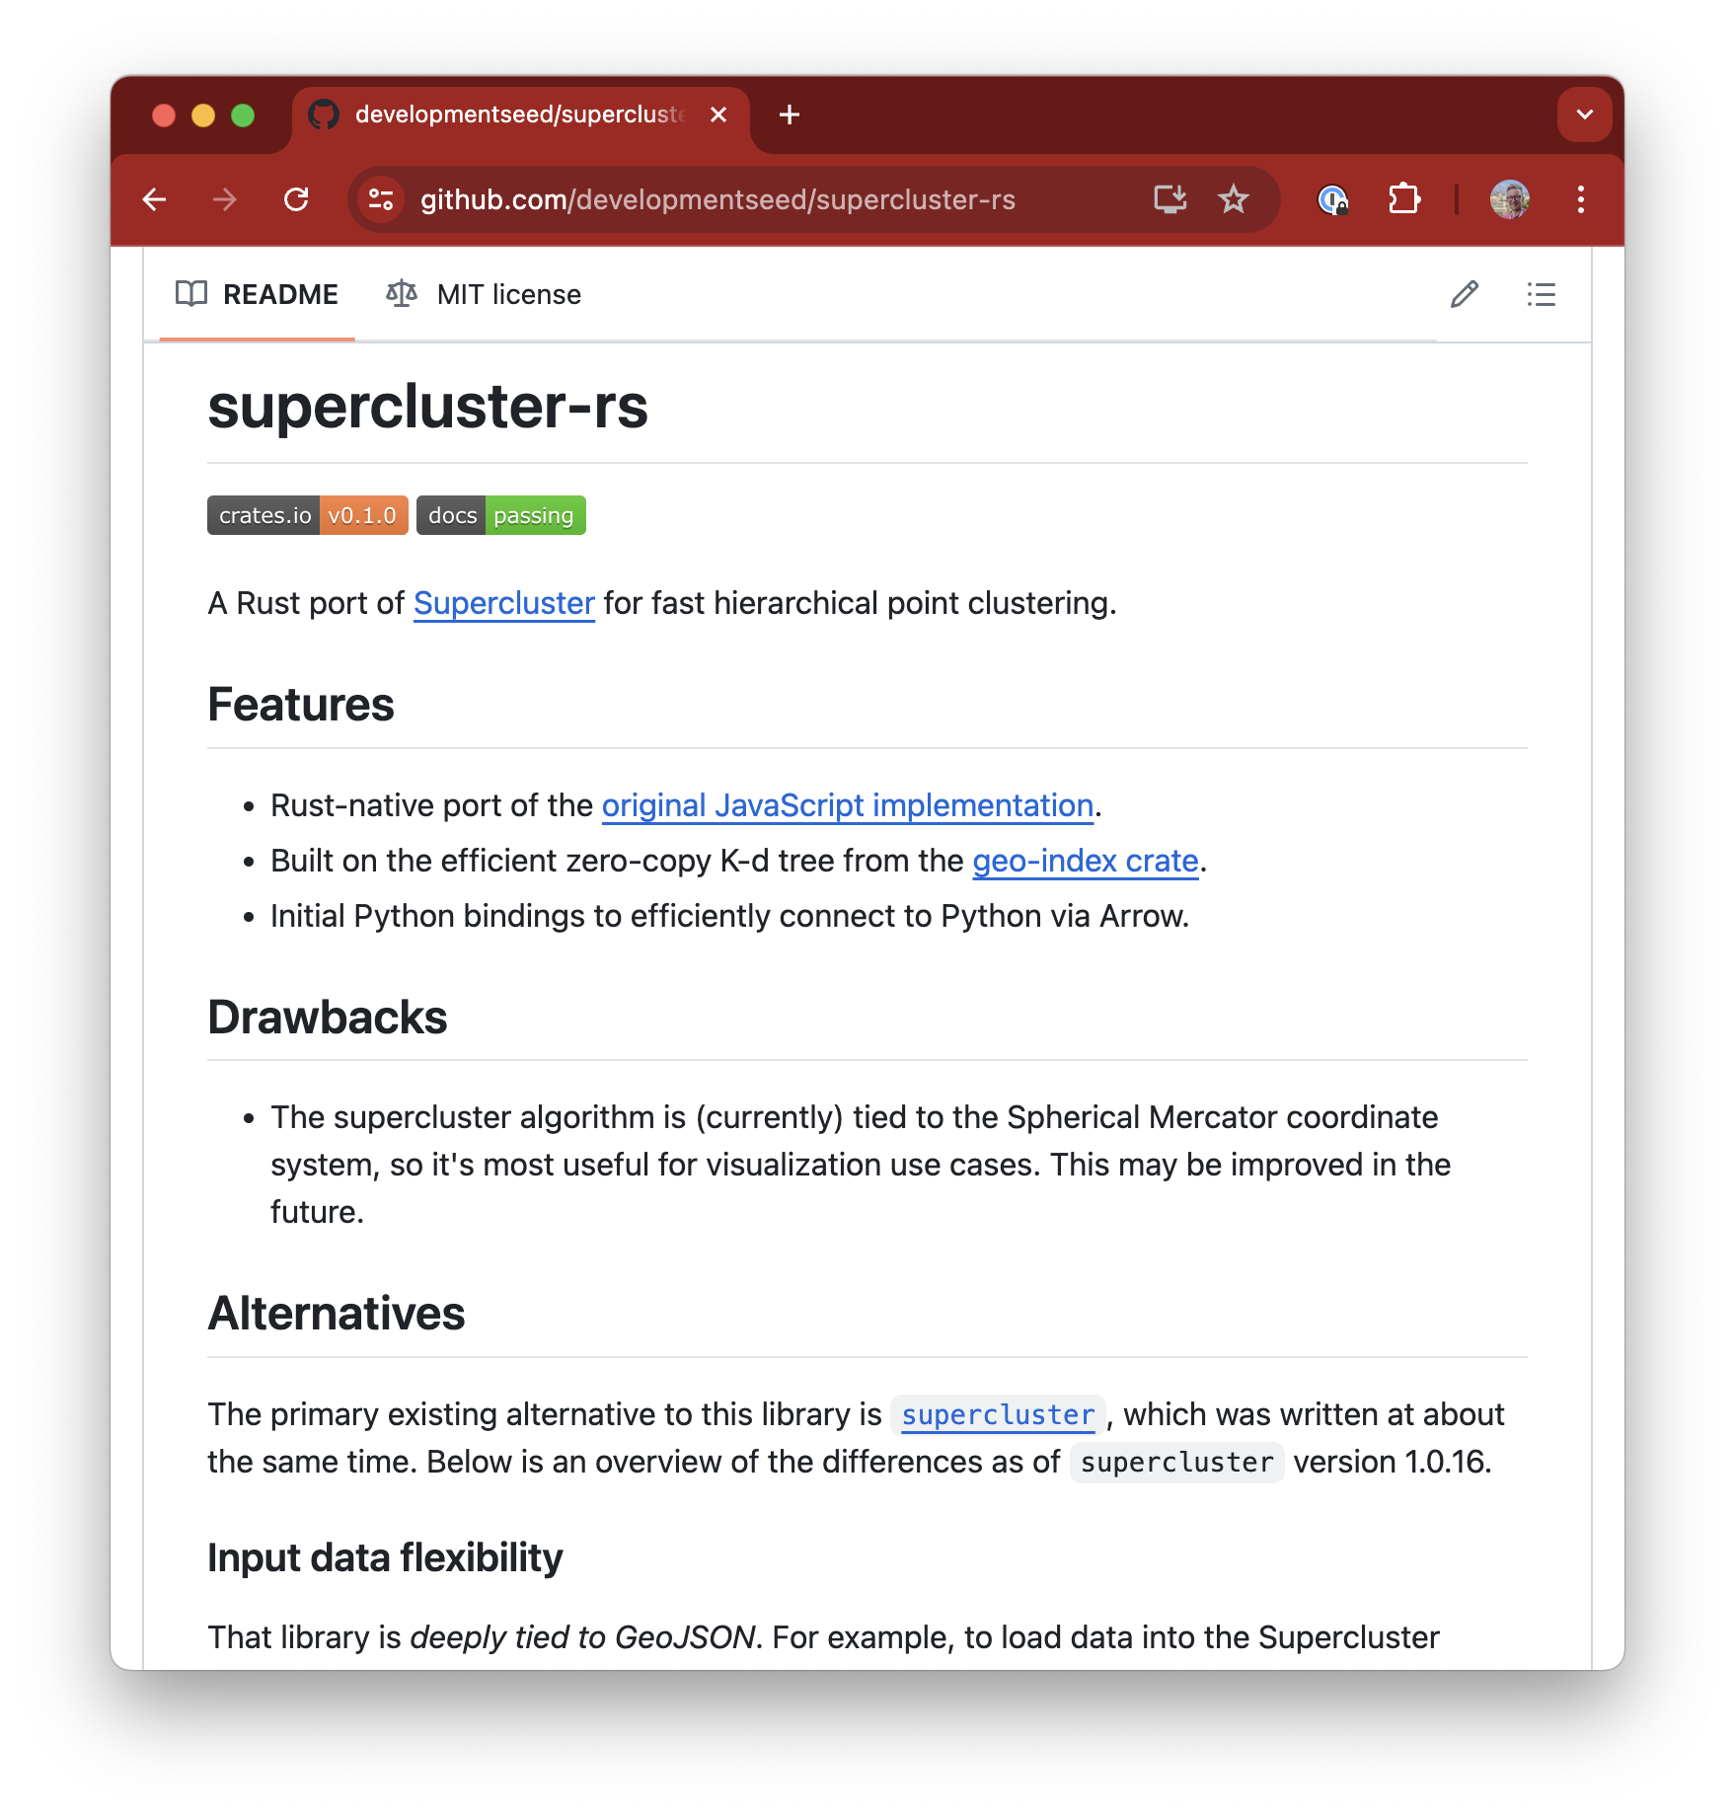
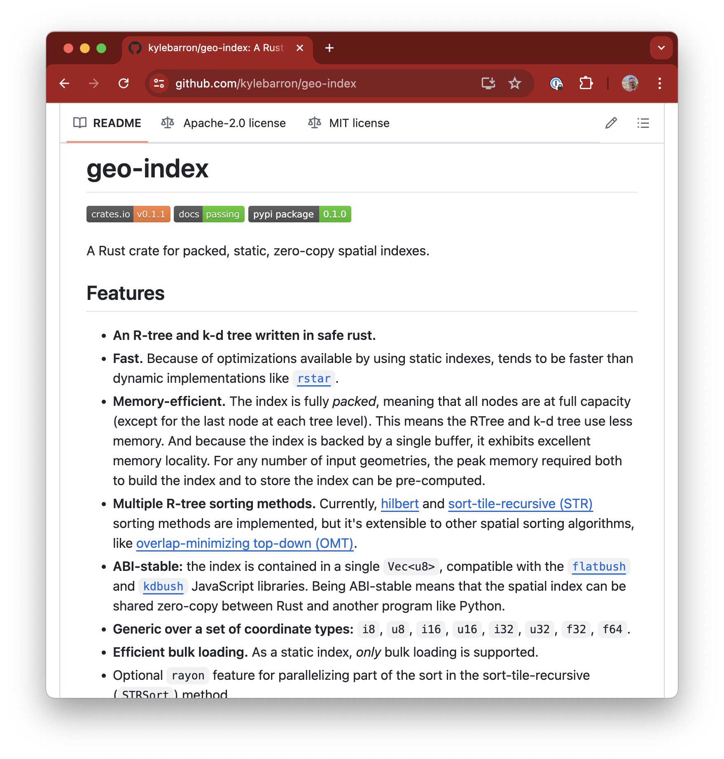
Scalable rendering
Today all user input is sent to browser
In the future:
Smarter relationship between Python and JavaScript
Efficient spatial indexes in Rust/Python
Transfer small portions of input, depending on map’s view

Slide 52
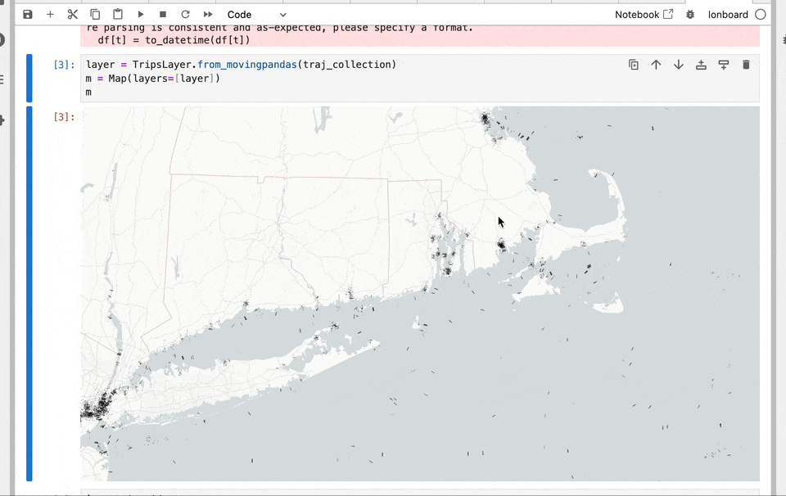
ds.io/lonboard
Future Work: Trajectory data

Slide 53
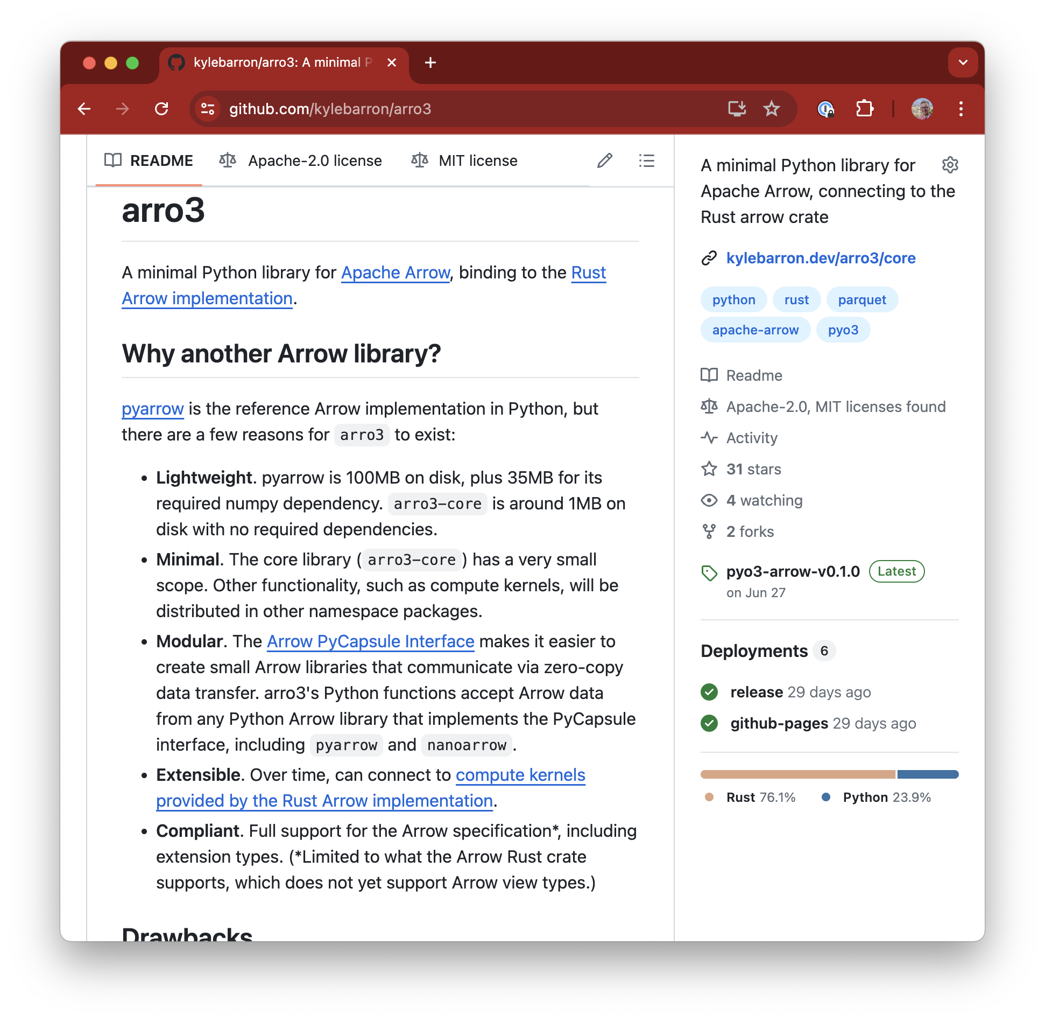
Lonboard: Slim down dependencies
No required dependencies on Pandas, GeoPandas, Shapely, pyarrow
Swap out pyarrow for arro3
Enables Lonboard in Pyodide in WebAssembly (fully client side, no server)
Treat Arrow as the first-class citizen; everything else is a connector.

Slide 54
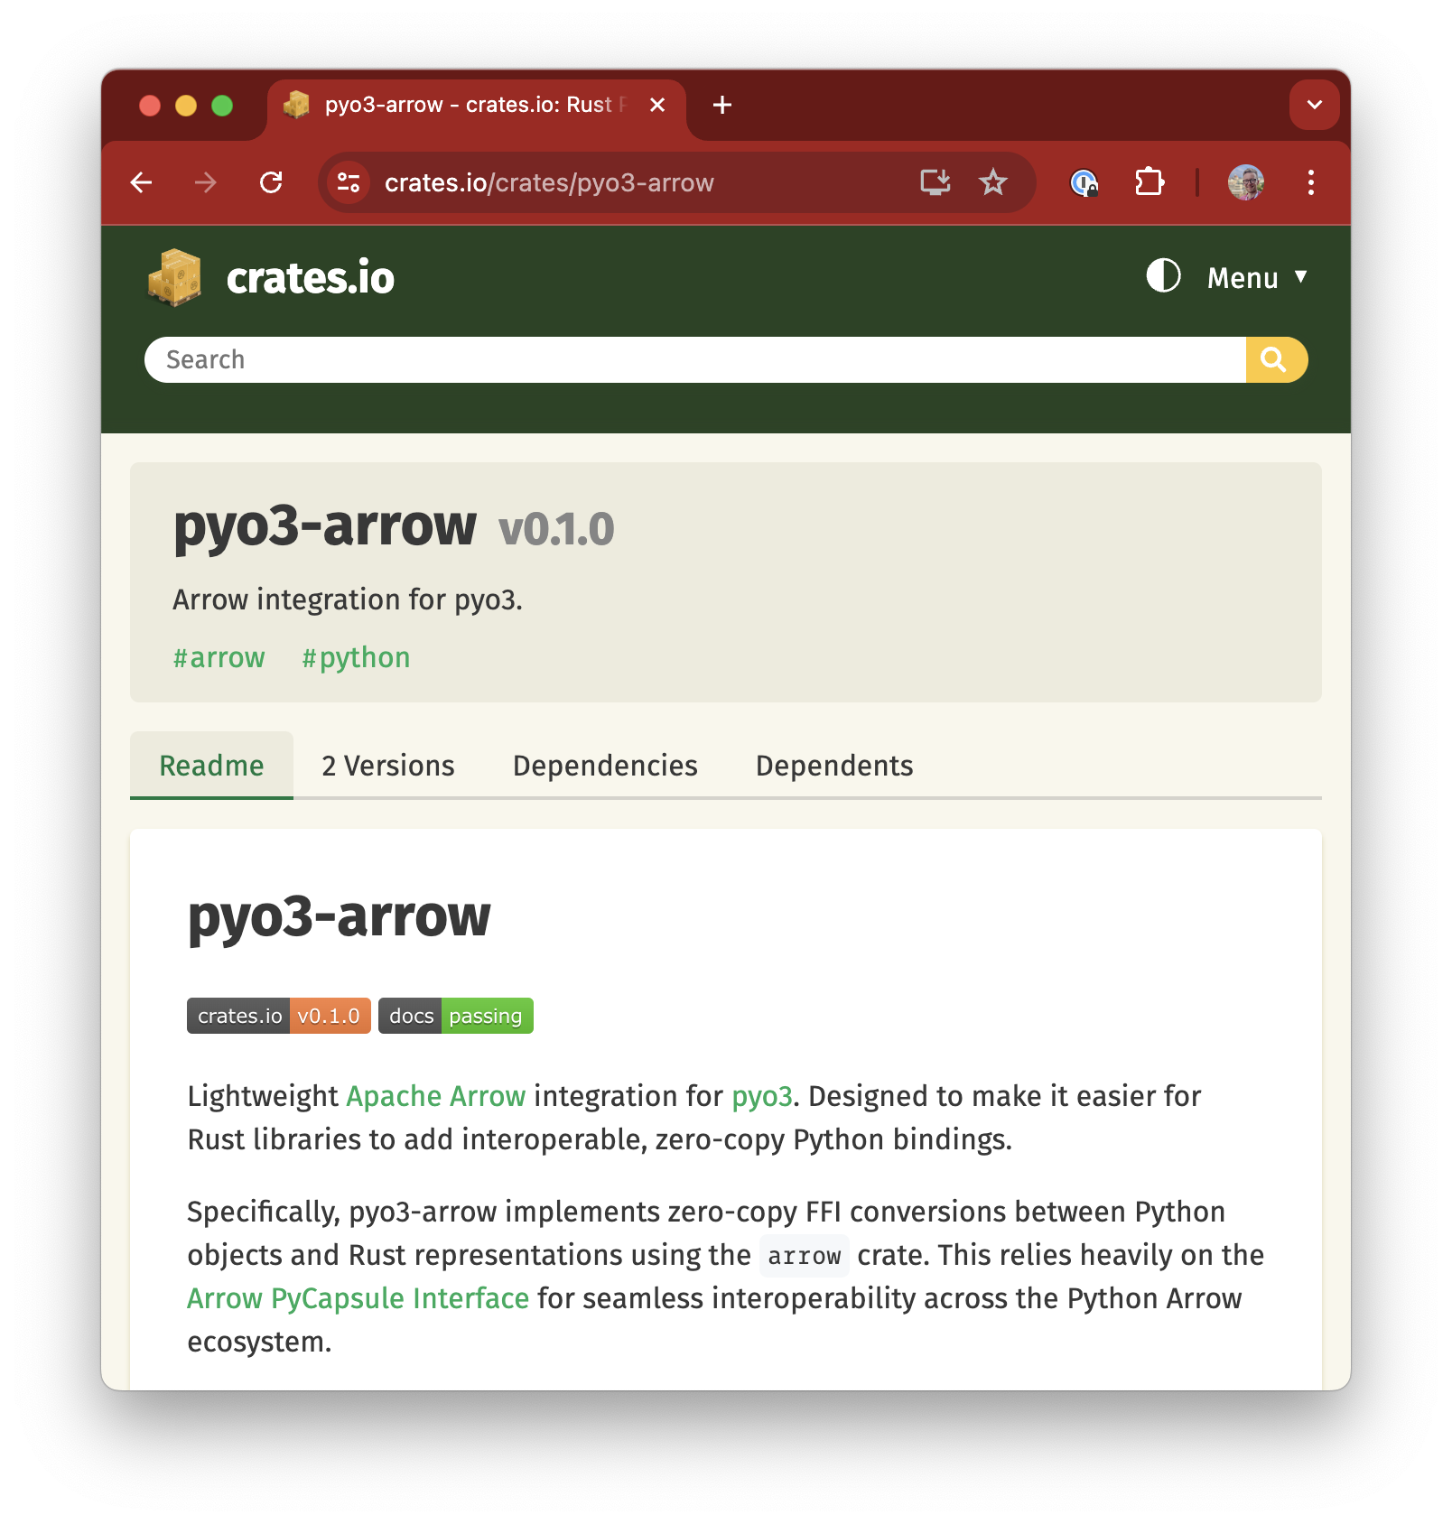
Grow Arrow/GeoArrow ecosystems
Advocate for/implement PyCapsule interface in more libraries
Make it easier for developers to add Arrow
pyo3-arrow simplifies passing Arrow data to/from Rust and Python
Push for geospatial support and/or extensions:
geoarrow-rust
GeoPolars

Slide 55


An exercise for the reader
Lonboard + Reticulate
Should be possible to connect Lonboard - Reticulate - geoarrow-r
PyCapsule interface should work with reticulate
Zero-copy data sharing between R and Python 👉
Danielle Navarro (Passing Arrow data between R and Python with reticulate)

Slide 56

Learn More
ds.io/blog
ds.io/Lonboard
geoarrow.org
anywidget
Podcasts:
Mapscaping (GeoParquet)
Matt Forrest (Lonboard & GeoArrow)
Browsertech (JavaScript/WebAssembly)

